Slide 1
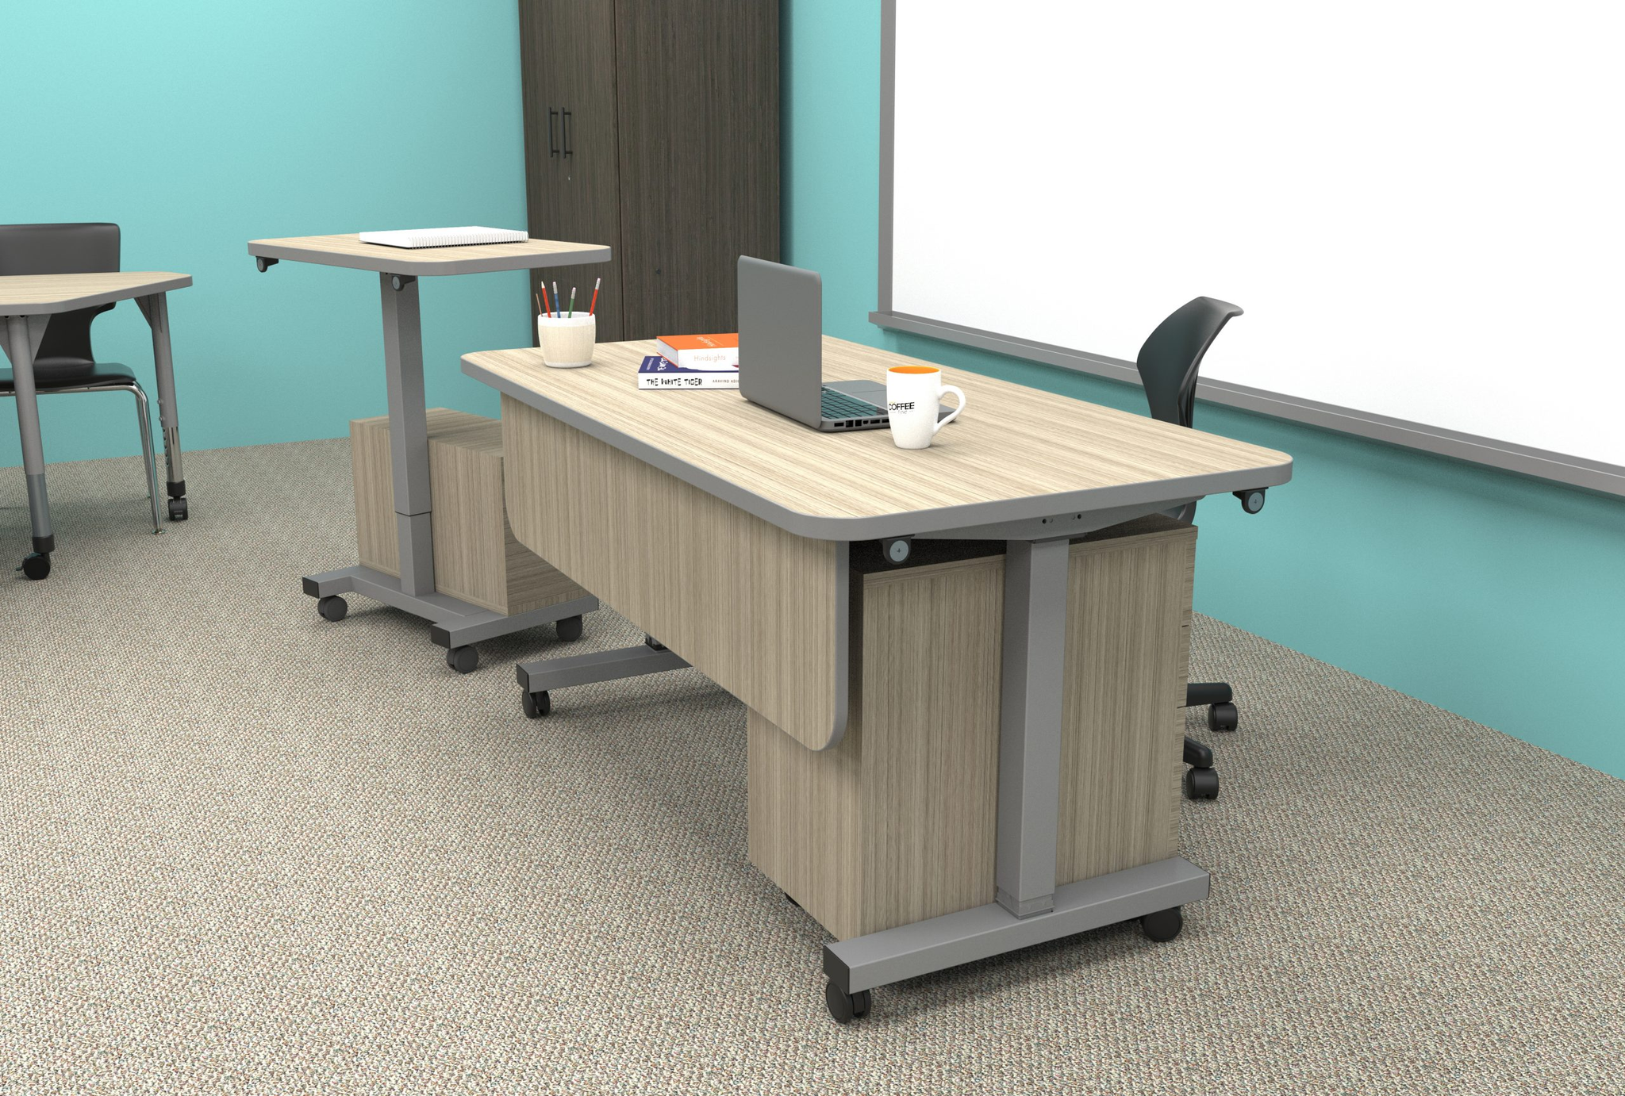
_{CUE™}
TEACH WITH PRESENCE. MOVE WITH PURPOSE.
In the classroom, presence is everything. How a teacher moves can command attention, shift energy, or create connection. It’s more than posture—it’s purposeful motion.
CUE™ was built for that kind of teaching
This next-generation pneumatic desk and mobile podium gives you full control over how and where you engage. The podium detaches easily and rolls with you—so you can stand in front of your class, guide a small group, or collaborate one-on-one. When it’s time to reconnect, the magnetic base locks back in place, transforming into a stable workspace.
Smooth pneumatic height adjustment helps you shift from sitting to standing without breaking stride. Durable materials, clean design, and optional storage make CUE as practical as it is flexible.
Whether you’re leading the room or working side by side, CUE™ moves with you. Because when you’re on cue, your students are, too.

Slide 2
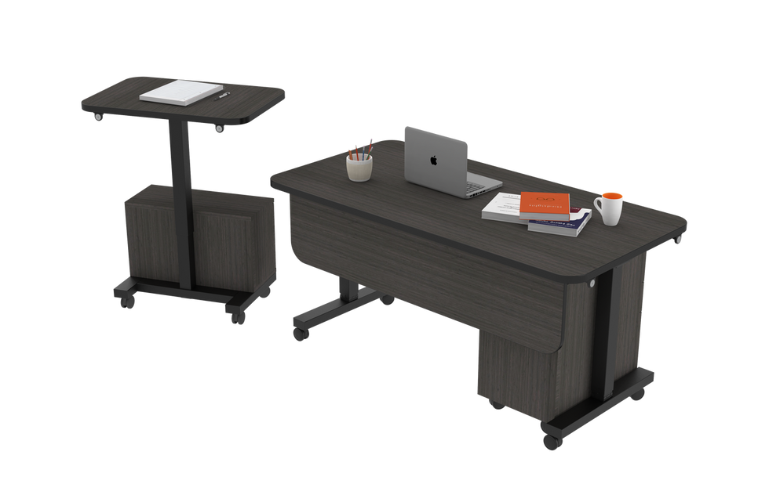


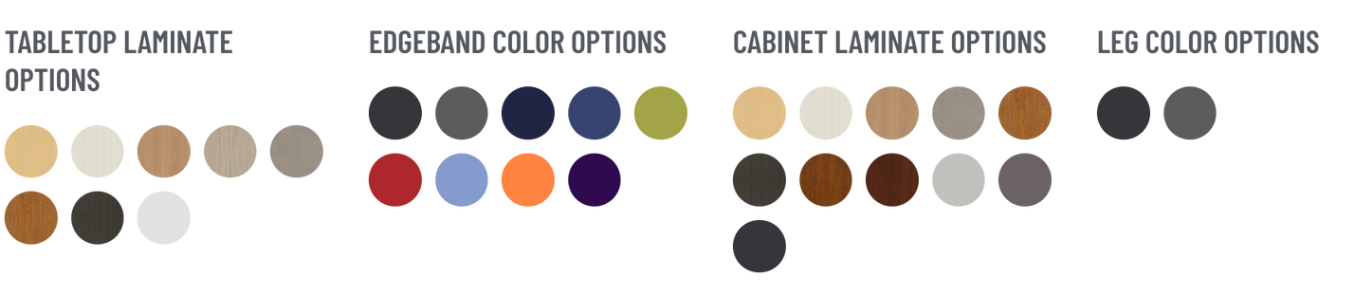

PRODUCT OVERVIEW
Category: Tables & Desks
Cue™ Pneumatic Desk & Podium Collection
Smart Features That Keep You Moving:
  Pneumatic Lift: Effortless height changes from 28" to 42"
  Magnetic Podium: Detaches and reattaches in seconds
  Durable Top: 1-1/8" thermally fused melamine
  Mobile Ready: Locking swivel casters for smooth classroom transitions
  Optional Storage: Add drawer and podium cabinets to stay organized

Slide 3
PRODUCT POSITIONING MODEL
Purpose
People
Process
Service
Infrastructure
Why
Who
What
How
When/Where
To create enduring, flexible learning environment through thoughtfully engineered desks that adapt, not break. We build for the long haul–because learning deserves better.
Made for teachers, specified by architects, supported by dealers. Built for those shaping learning—from design to install, with every classroom in mind.
A mobile, ADA-compliant desk & podium system. Silent lift. Lockable storage. Modular podium. GREENGUARD Gold certified. Built to support how teachers teach.
Backed by Marco’s 10-year warranty and responsive dealer support. Cue desks arrive install-ready and built to perform—classroom after classroom, year after year.
Ideal for classrooms, labs, and flex zones. Works in new builds or retrofits. Ready for summer installs, fully-assembled, quick turns, and long-term value.

Slide 4
SWOT ANALYSIS
Power-free pneumatic lift (no cords or outlets)
Complete flexibility within environment
Modular, multi-functional podium Magnetic attachment between desk & podium
Locking swivel casters = excellent mobility
Customizable with wide range of finishes
GREENGUARD GOLD Certified (eco-safe) Design-forward aesthetic Promotes well-being
Manual adjustment may deter some users
Lacks integrated cable management or tech ports
Niche design primarily targets educational buyers
Limited size and shape options
Less competitive in tech-heavy or executive office markets
S
W
O
T
Growing demand for flexible, ergonomic school furniture
Corporate wellness and hybrid work trends
Rise in sustainable/eco-conscious procurement
Add-on/bundled solutions with storage
Bundled solutions with storage or seating
Aggressively prices and lower than our competitors
Competitors with motorized desks & memory presets
Cheaper imported desks may undercut on price
Stand-up desk market is maturing and crowded
Customer expectations shifting toward smart features
Institutional budget restrictions (education/government)

Slide 5
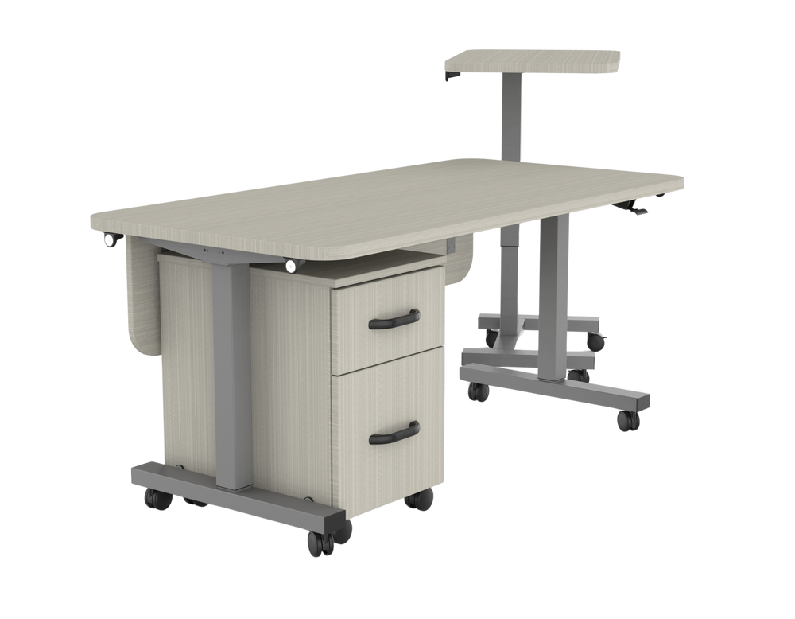
Modular Design That Adapts Instantly
UNIQUE SELLING POINTS
Power-Free Flexibility, Zero Downtime
Switch podium placement left or right, add or remove storage, and move the desk easily with locking casters.
Most competitors rely on electricity or manual cranks–Cue's pneumatic lift hits the ergonomic sweet spot with none of the downsides.
Extreme Durability for Years of Use
Built on Trust. Delivered with Care.
Built with thermally fused laminates, steel leg frames, and 3mm PVC edge banding–crafted to withstand years of heavy classroom use.
Lower cost. Highest marks for quality.
Preassembled shipping, low SKUs, and dependable lead times meet dealer pain points head-on.
While other desks might cut corners to cut costs, Cue delivers unmatched value with heavy-duty construction, thoughtful design, and classroom-tested durability.

Slide 6
AUDIENCE ANALYSIS
Users
Specifiers
Channels
Teachers
A&D / Procurement
Dealers
Needs & Prorities
Needs & Prorities
Needs & Prorities
Comfort, mobility, intuitive height adjustability, real storage, cord-free, flexibility in teaching styles
Clean aesthetic, ADA compliance, ergonomics, easy specification, and clean installs.
Good margins, fast lead times, exclusive product options, ease of fulfillment
Emotional Drivers
Emotional Drivers
Emotional Drivers
Want tools that make teaching smoother and support how they move, engage, and connect–not just sit behind a desk.
Wants to design spaces that are healthy, beautiful, and adaptable
Wants to win bids with confidence, reduce logistical pain, and be seen as a trusted advisor
What Marco Offers
What Marco Offers
What Marco Offers
Cue’s silent pneumatic lift, magnetic podium, mobile storage, clean wire-free design
Multiple laminates/finishes, GREENGUARD Gold, CET-ready specs, ADA range, sleek industrial frame
Differentiated product, dealer-friendly price strategy, easy to do business with, high reliability

Slide 7
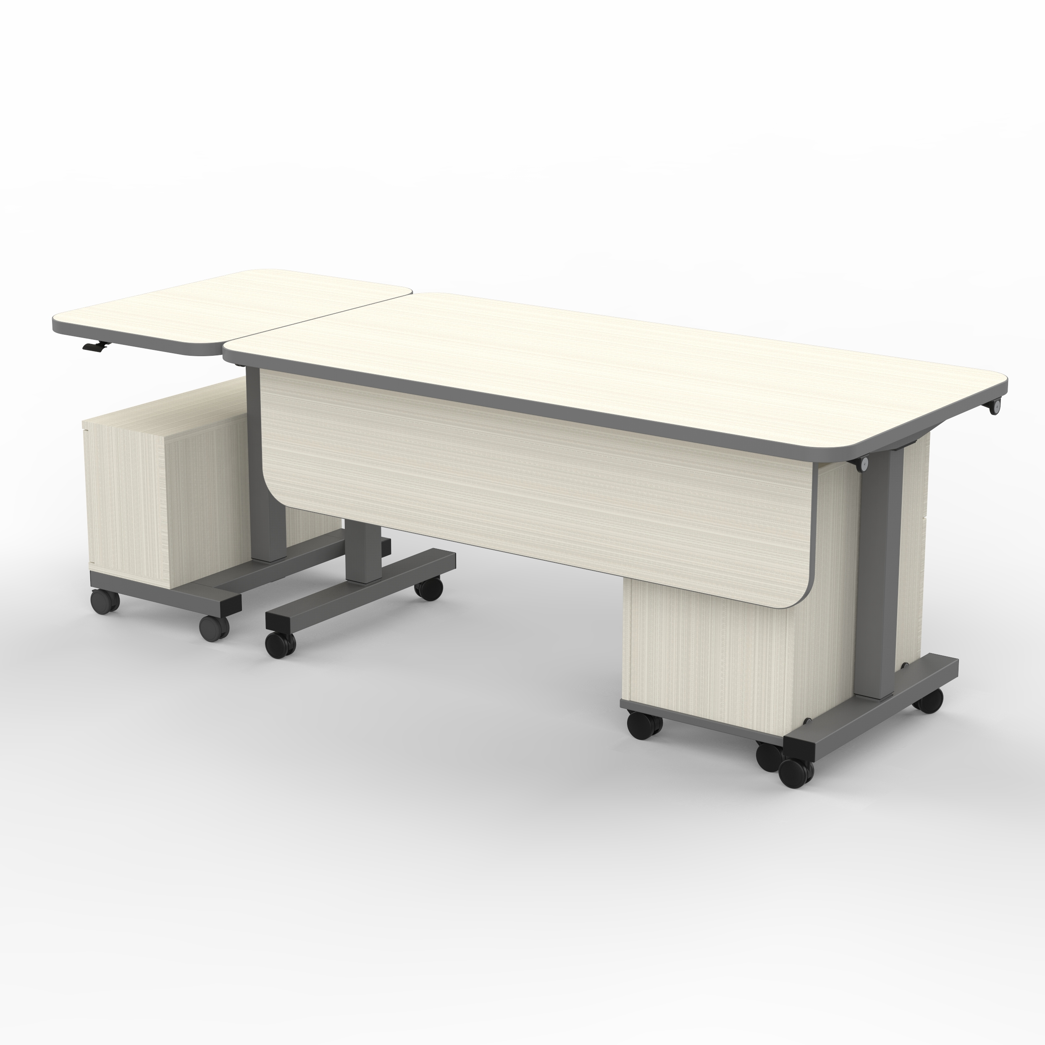
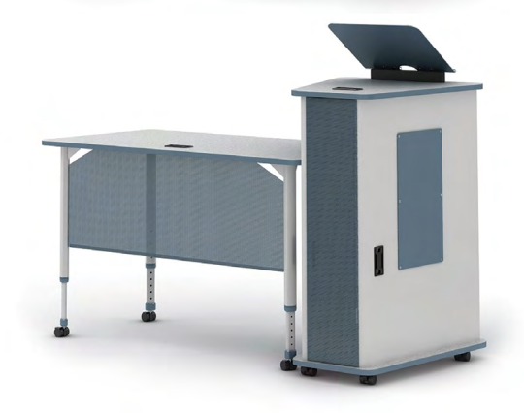
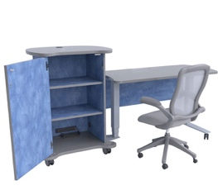
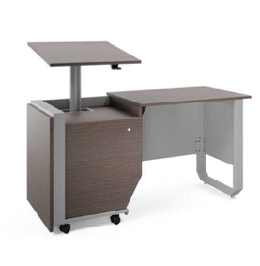
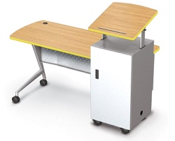
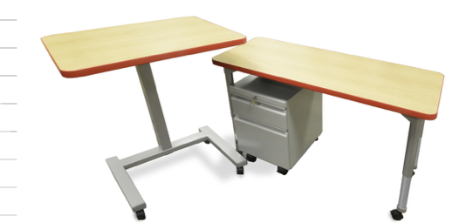
COMPETITIVE ANALYSIS
Feature | Marco (Cue Collection) | Paragon Furniture (A&D Crossfit) | CEF (Sit-to-Stand Desk | Mooreco (Trend Podium Desk) | Artcobell (Arise Podium) | Smith System (Motum Split-Height)
Adjustable Height | 28" – 42" (Pneumatic) | Fixed 40" height | 29" – 49" (Pneumatic) | 43" – 49" (Podium), 30" desk height (adjustable podium) | 29" – 49.5" (Pneumatic) | 60″ Split-height (Pneumatic podium)
Dimensions | Desk: 60"W × 30"D × 28" – 42"H Podium: 30"W × 20"D × 28" – 42"H | Podium: 24"W x 30"D x 40"H Desk: 48"W x 24"D x 24"–34"H | Podium: 29"W x 20"D x 41"H Desk: 23"W x 48"L Combined Length: 77" | Desk: 42"W x 24.5"D x 30"H Podium: 19.8"W x 20.8"D x 43" – 49"H | Desk: 30"W x 48"D, adjustable 29" – 48.5"H Podium: 24"W x 36"D, adjustable 29" – 48.5"H | Overall: 24"W x 60"D x 30"H Podium: 24"W x 24"D x 30" – 44"H
Height Adjustment Mechanism | Pneumatic lever adjustment | None | Pneumatic lift (podium & desk) | 6" of tilt/height adjustment on podium | Single hand lever with smooth height control | Manual lift for split height adjustment
Weight Capacity |  | 65 lbs (podium) + 50 lbs (desk) | 270 lbs | 160 lbs | Unknown | 227 lbs
Certifications | UL GREENGUARD GOLD Certified | Compliance with ANSI/BIFMA | Indoor Advantage™ Gold | SCS Indoor Advantage Gold | ANSI/BIFMA Standards, Indoor Advantage Gold | GREENGUARD Gold Certified
Warranty |  | 5 Years | 12-Year Warranty | 1-Year (finish defects), 10-Year (structural warranty) | 12-Year Warranty | Limited Lifetime Warranty
Mobility | 3" locking swivel casters | Dualie casters on podium | All-locking swivel casters | 3" locking non-marring casters | Casters can be added for an additional charge | Wheelbarrow design (glides + lockable casters)
Storage Options | Optional 3-drawer cabinet and podium cabinet | Locking door, adjustable shelves | Locking door, 2 adjustable shelves, surge protector | 2 adjustable shelves, locking storage | Lockable storage, multiple shelf options | Lockable storage, left/right podium options
Assembly Complexity |  | Minimal assembly required | Ships partially assembled | Some assembly required | 2-person assembly recommended | Full assembly required
Unique Selling Points | - Magnetically attached podium for quick transitions- Smooth pneumatic lift with secure locking- Multiple finish and edge customization options- Opt`ional mobile storage solutions (cabinet + podium) | - Crossfit podium with kickstand- Locking storage with flexible configurations- Kickstand doubles as a projector stand | - Locking storage with integrated power- Podium and desk can be ordered separately- Multiple laminate choices | - Combines podium and desk for a flexible workspace- Tilted podium with 6" height adjustment- Locking shelves for added security | - Fully welded frame for durability- Height adjustment via a single lever- Customizable with field-installed accessories | - Split height for left/right work configurations- Lockable casters and mobile podium design- Multiple size and laminate options
List Price | $2,780 |  | $3,150 | $2,452 | $5,124 | $2,939
Catalog Dealer Price | $1,890 (est. 32% dealer margin) | $2,050 | $2,309 | $1,520 | $3,400 | $1,823

Slide 8
PRICING
4 | x multiplier
Item No | Desc | Cost | MSRP | Dealer Price | Margin @ Dealer Price | Margin @ MSRP
371306 | Desk | $251.00 | $1,004.00 | $451.80 | 44% | 75%
372104 | Podium | $106.00 | $424.00 | $190.80 | 44% | 75%
371708 | Cab-2 Drw | $338.00 | $1,352.00 | $608.40 | 44% | 75%
371710 | Cab-3 Drw | $397.00 | $1,588.00 | $714.60 | 44% | 75%
371709 | Podium Cab | $191.00 | $764.00 | $343.80 | 44% | 75%
 | Bundle | Cost | MSRP | Dealer Price | Margin @ Dealer Price | Margin @ MSRP
 | Desk + Podium + Cab-2 Drw | $695.00 | $2,780.00 | $1,251.00 | 44% | 75%
 | Desk + Podium + Cab-3 Drw | $754.00 | $3,016.00 | $1,357.20 | 44% | 75%
 | Desk + Podium + Podium Cab | $548.00 | $2,192.00 | $986.40 | 44% | 75%
 | Desk + Podium + Cab-2 Drw + Cab-3 Drw | $1,092.00 | $4,368.00 | $1,965.60 | 44% | 75%
 | Desk + Podium + Cab-2 Drw + Cab-3 Drw + Podium Cab | $1,283.00 | $5,132.00 | $2,309.40 | 44% | 75%

Slide 9






PRODUCT POSITIONING MAP
Marco: Cue™
CEF: Sit-Stand Teacher Desk
$5,124.00
Purpose-built for educators, Cue combines ergonomic freedom, mobility, and modularity—without cords or high cost. Durable and beautiful, at the best value.
Electrified sit-stand unit with built-in power. Not ideal for classrooms lacking outlet access. High price with lower long-term adaptability.
High Price
Paragon: A&D Crossfit
Smith System: Motum™
Entry-level, cost-effective podium. Lacks adjustability and is not pneumatic. Less appealing for modern classrooms needing movement and flexibility.
Trusted name in K–12. High-quality and ergonomically sound, but often higher priced and less modular than Motu. Pneumatic lift not standard in teacher stations.
MooreCo: Trend Podium Desk
artcobell: ARISE Double & Podium
Low Price
Stylish, well-featured desk with storage and adjustability. Expensive and bulky for schools seeking simplicity and modular use.
Direct challenger to Cue. Strong adjustability, high build quality, and made in the USA. Slightly more expensive, but compelling for premium buyers.
$2,400
Low Quality
High Quality
Notes:
Provide price ranges

Slide 10
MESSAGING THEMES
Made to Move With You
The classroom isn’t static, and neither are you.
Cue™ adjusts with a single pull, rolls smoothly across the room, and keeps up as you shift from guiding a group to leading a lesson. It’s built for the rhythm of real teaching.
2. Your Desk. Your Way. Every Day.
No two teachers teach the same. Cue™ makes room for that.
Customize your setup—podium on the left or right, storage where you need it, standing or sitting in seconds. It's your space, finally built for you.
3. Stand Up. Sit Down. Teach On.
No buttons, no power cords—just a quiet lift when you need it.
Switch between sitting and standing on the fly. Cue™ keeps you energized and ergonomic without ever needing an outlet.
4. Built for the Wear and Wonder of Every School Day
Teaching is tough. Your desk shouldn’t be.
From thermally fused surfaces to steel-leg durability, Cue™ is built to take what the day throws at it—coffee spills, lesson plans, late nights, and all.
5. Smart Where It Counts
Simple where you want it. Thoughtful where you need it.
Magnetic podium placement. Lockable drawers. Smooth mobility. Every feature on Cue™ was designed to help—not distract—you.
6. Quietly Powerful
No motors. No noise. No classroom disruption.
Cue’s pneumatic lift adjusts smoothly and silently—letting you transition mid-lesson without losing momentum or your students' focus.

Slide 11
ASSETS & TIMELINE
April 11 – Spec Sheets, E-Cards, Sell Sheet
April 22 – Orders Can Be Placed / Launch Date
June 9 – Product in Warehouse
July 1 – First Shipment Date
November 5 – External Beta Tests (EdSpaces)

