Slide 1
Encore Cart
Product Launch Overview
September 2025

Slide 2
Product Overview
ENCORE CART
Storage that takes center stage.
Meet the Encore Cart: your school band, theater, and choral programs’ ultimate storage sidekick. Built with a steel frame, dual hanger bars, and smooth-swiveling casters, it moves effortlessly while keeping uniforms, robes, and costumes perfectly organized. Height-adjustable and crafted for durability, Encore delivers practical, everyday performance—without the premium price tag.

Slide 3
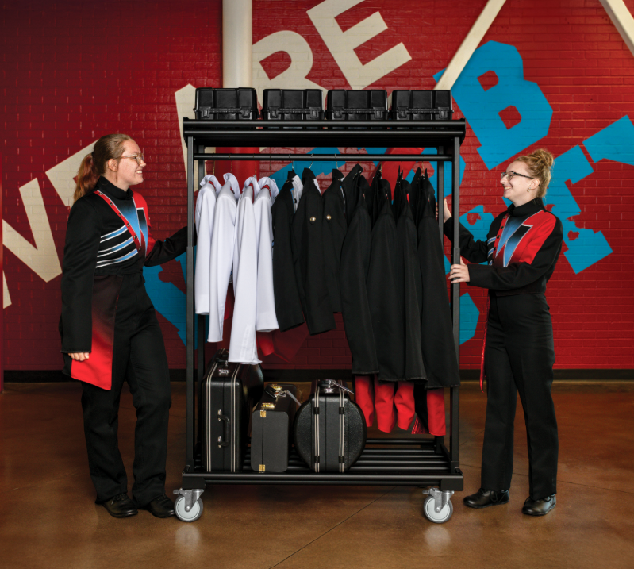
Features + Benefits
Storage that takes center stage.
DETAILS | ENCORE
Retail Price | $829
Load Capacity | 300 lbs
Hanger Bar Capacity | 150 lbs
Top Shelf Capacity | 25 lbs
Weight (product only) | 85 lbs
Dimensions (WxD) | 47” x 24”
Height Adjustability | 56” – 86” in 6” increments
Material – Upright | 14-gauge steel
Material – Shelves | 23 – gauge steel
Casters | 5” heavy-duty swivel
Lower Hanger Bar | Removable
Assembly | Ships partial assemble
Warranty | 10-year limited

Slide 4
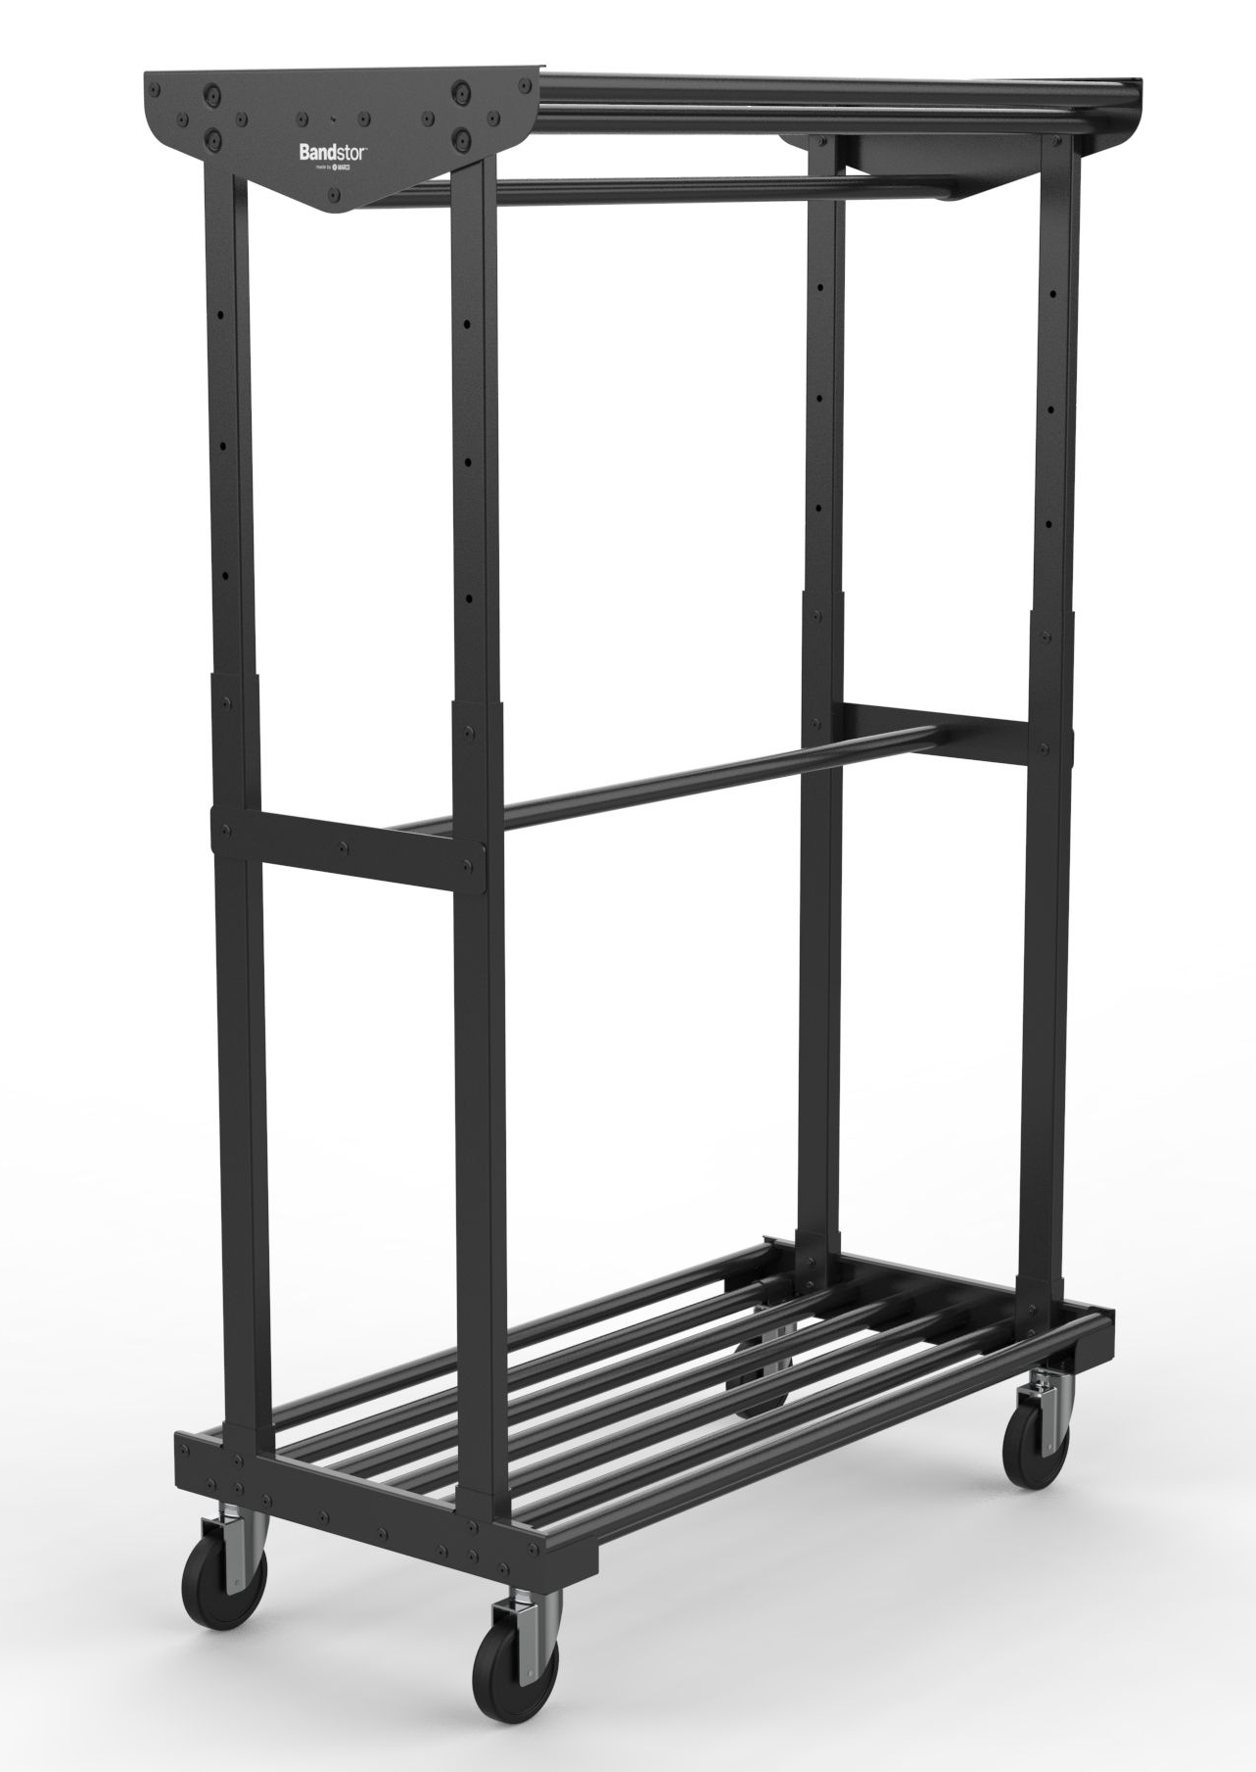

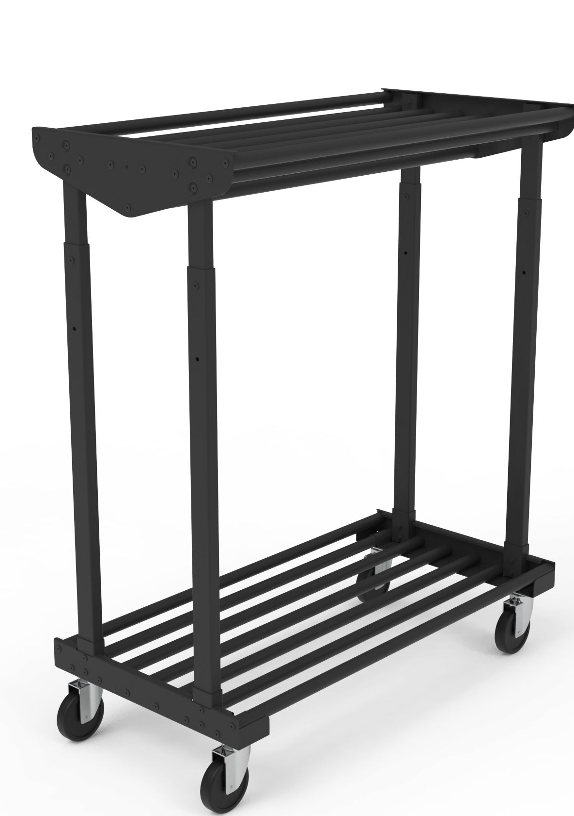
Features + Benefits
ADJUSTABLE HEIGHT
Telescoping steel uprights adjust from 56" to 86" in 6" increments.

Slide 5
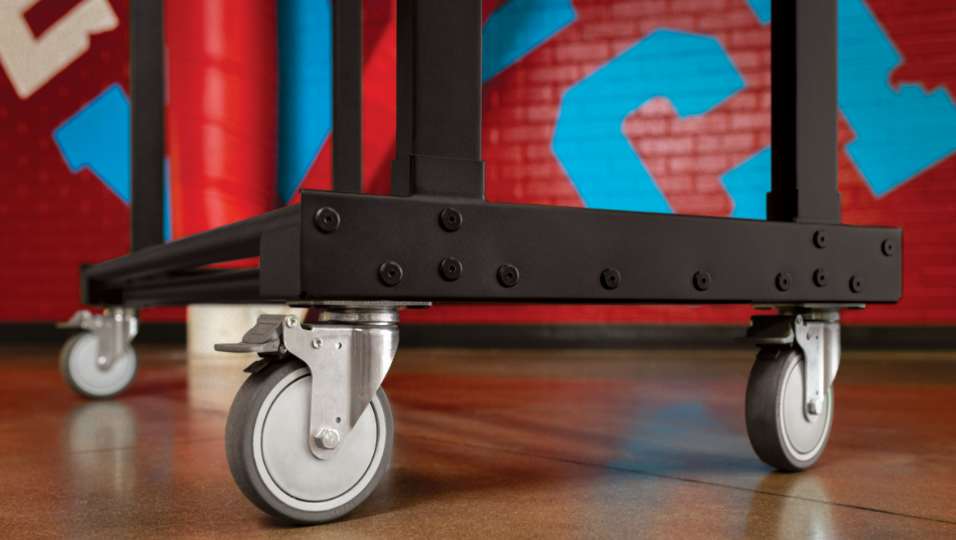

Features + Benefits
EASY MOBILITY
5" smooth-rolling casters make transport easy across stages, hallways, or storage areas.

Slide 6
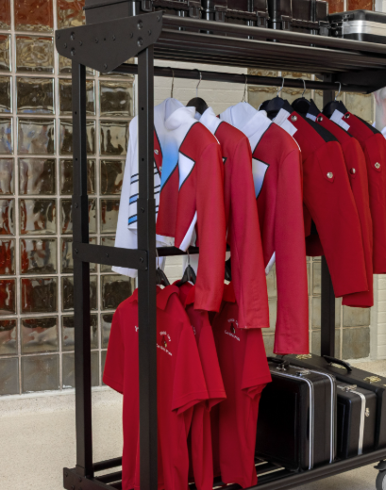

Features + Benefits
DUAL HANGER BARS
Upper and lower bars provide generous space for uniforms, costumes, or coats.

Slide 7
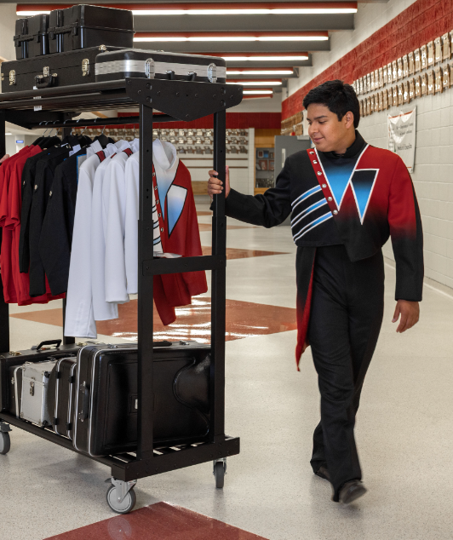

Features + Benefits
LIGHTWEIGHT + TOUGH
At just 85 lbs, Encore is easy to handle—but strong enough to last.

Slide 8
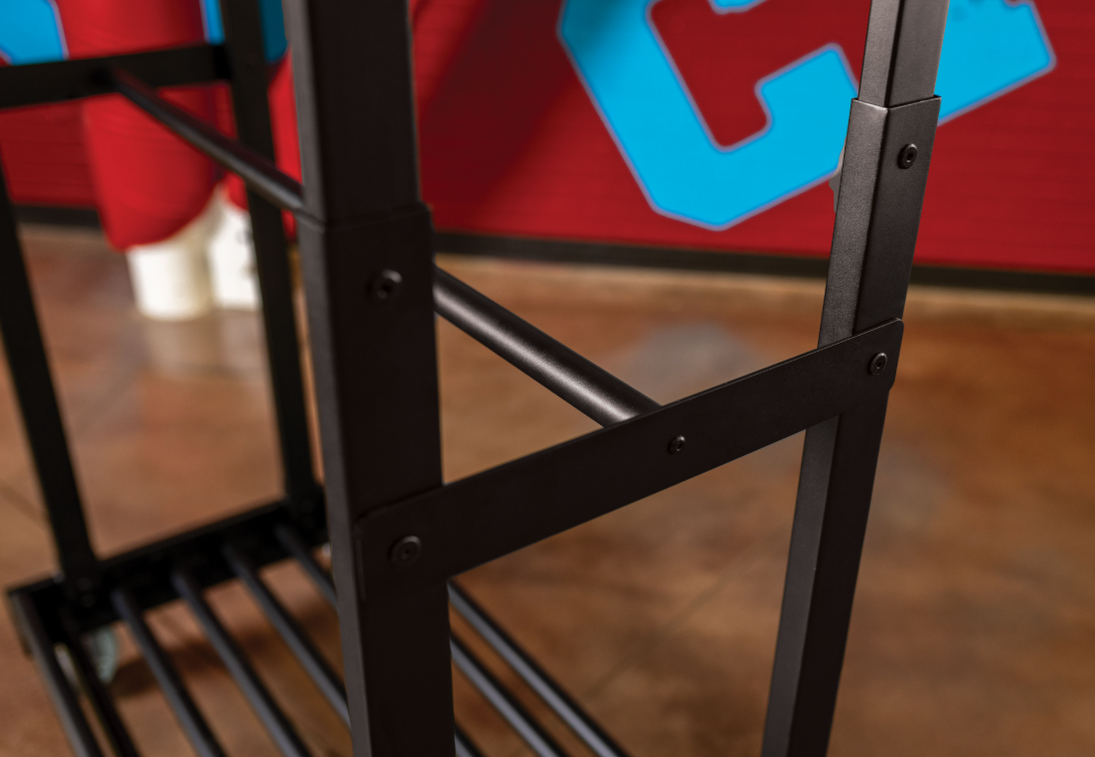

Features + Benefits
DURABLE STEEL FRAME
Built with 14-gauge and 21-gauge steel, the Encore Cart’s durable frame stands up to the toughest music, theater, and choral programs.

Slide 9
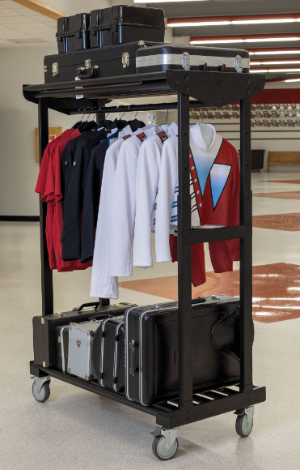

Features + Benefits
COMPACT FOOTPRINT
Fits through standard doors and stores neatly when not in use.

Slide 10
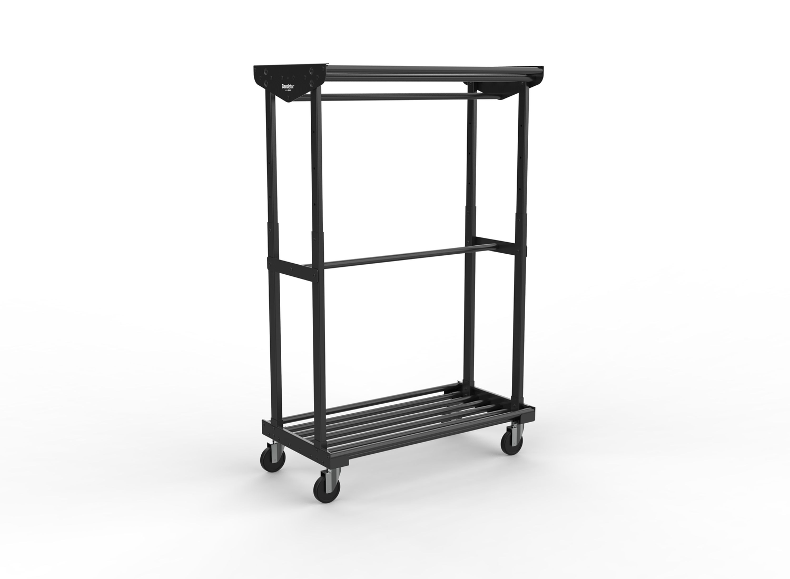
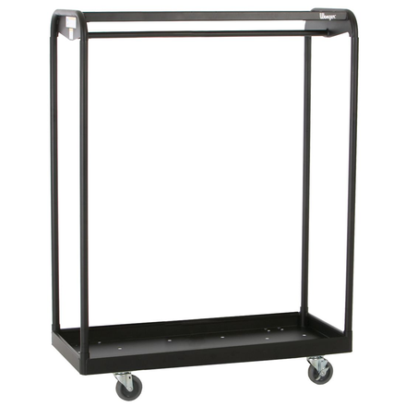
COMPETITIVE COMPARISON
ENCORE CART
RACK N ROLL
DETAILS | ENCORE | RACK N ROLL (6’)
Retail Price | $829 | $1291
Load Capacity | 300 lbs | 300 lbs
Hanger Bar Capacity | 150 lbs | 100 lbs
Top Shelf Capacity | 25 lbs | 25 lbs
Weight (product only) | 85 lbs | 163 lbs
Dimensions (WxD) | 47” x 24” | 72”x24”
Height Adjustability | 56” – 86” in 6” increments | N/A
Material – Upright | 14-gauge steel | 13-guage steel
Material – Shelves | 23 – gauge steel tube crossbars | 16-gauge steel upper, 14-gauge lower shelf
Casters | 5” heavy-duty swivel
Lower Hanger Bar | Removable | Fixed
Assembly | Ships partial assemble | Ships fully assembled
Warranty | 10-year limited | 10-year
Quick Takeaways:
Encore is up to $460 less per Rack N Roll cart (comparing 6’ cart model)
Encore’s Lower hang bar is removable for tall uniforms - Rack N Roll is not.
Encore is significantly lighter (85 lbs vs 163 lbs) – easy to handle
Encore has a higher degree of gauge steel construction than Rack N Roll.

Slide 11



