Slide 1


MAY 27, 2025
Premier™
Series Stacking Chair
LAUNCH PACKET

Slide 2
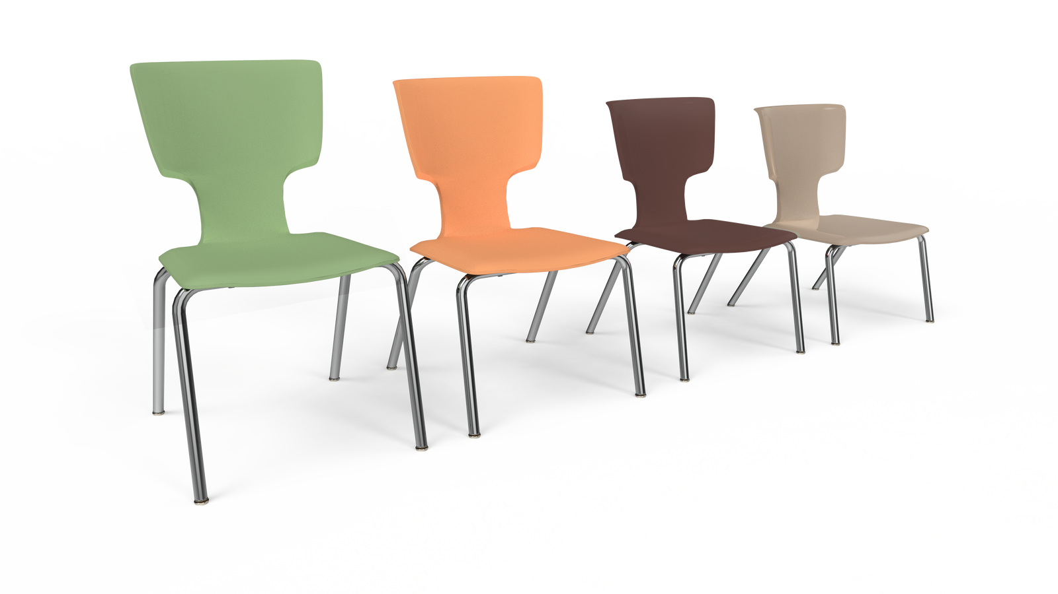

01
All-Around Comfort
03
Ergonomic Excellence
The unique four-sided waterfall edge offers smooth, rounded support no matter how you sit.
The contoured back is designed to cradle the body, keeping students
comfortable and engaged throughout the day.
02
Sit Your Way
04
Stack & Store
Whether you sit facing forward, backward, or sideways, the seat back offers a comfortable, natural armrest.
Practical stacking for easy storage without sacrificing style or support.
Product Overview
The Premier Chair is built for real classroom life—where students don't just sit; they move, lean, and shift. Thoughtfully designed for flexibility and comfort, it adapts to every position—frontward, backward, sideways, or leaning back.

Slide 3

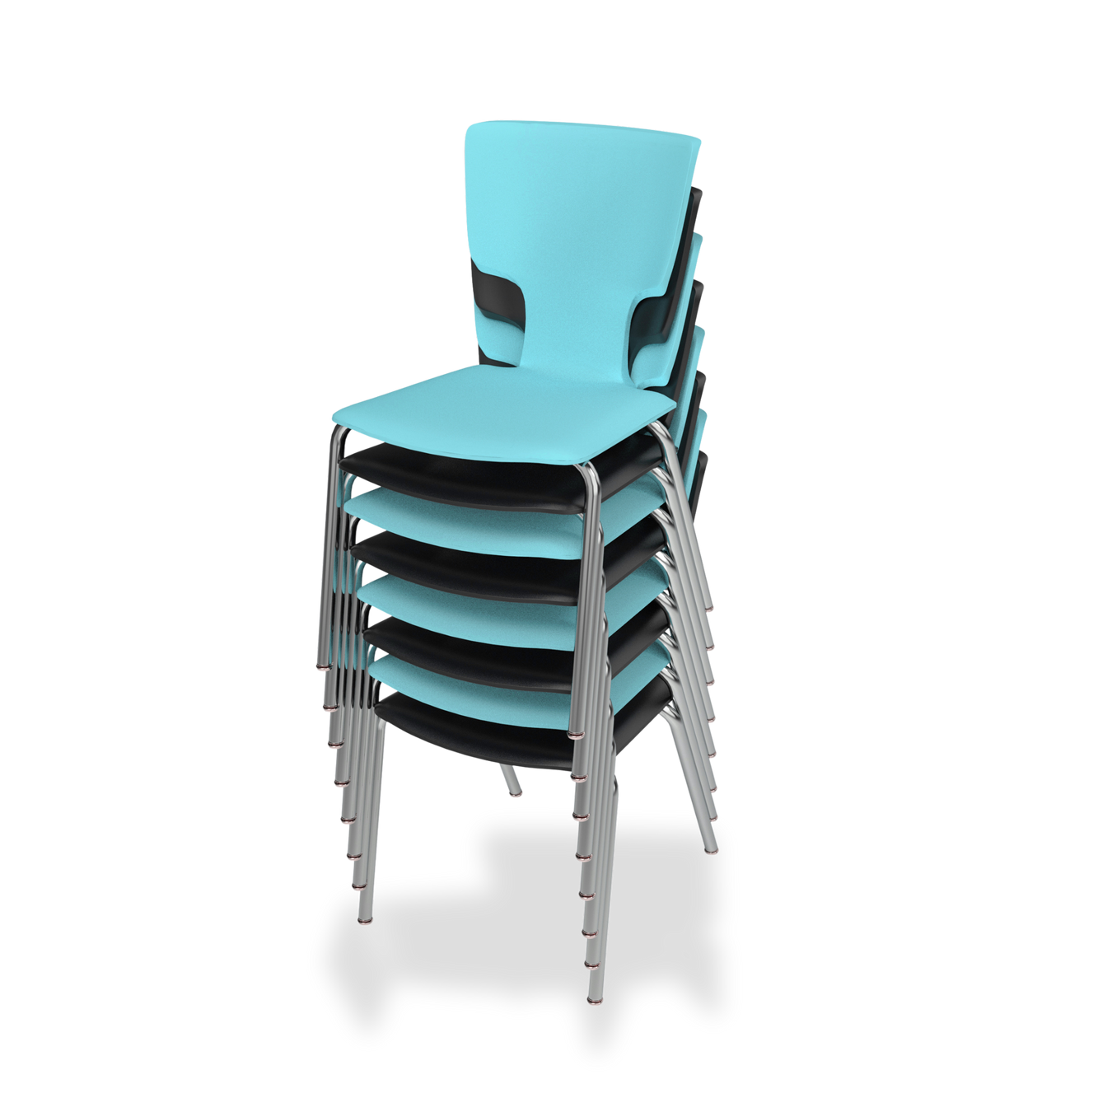
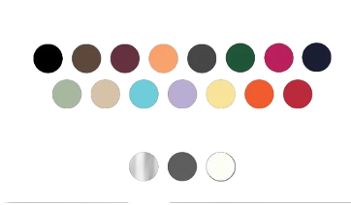
Four-Sided Waterfall Edge
Curves on all four sides for all-position comfort—front-facing, sideways, perched, or leaning.
Key Features
& Specs
Molded Contoured Back
Ergonomically sculpted for posture support and comfort over long periods.
Seat-Back Ledge
Functions as both a grip handle and a natural armrest when side-sitting.
Sizes
16”, 18” (12" & 14" coming fall 2025)
Seat Shell
Weight Capactiy
Durable polypropylene with flexible backrest.
18”: 250 lbs, 14/16”: 175 lbs, 12”: 100 lbs
Frame
1-1/8” tubular steel with welded steel brackets for added strength.
Finish Options
Shell Colors: 15+ vibrant options
Glides
Legs: Chrome or powder-coated gray.
Nickel-plated, self-leveling nylon glides (optional felt glides for noise reduction).
Stackability
Chairs stack 8–10 high, maximizing storage and install efficiency.

Slide 4
Pricing
Item No. | Description | MSRP | 45.00% | Cost | Margin %
43101-16CR-ANA | Premier Chair,16 In. Chrome Frame/Navy Shell | 171.00 | 76.95 | 39.4005 | 48.8%
43101-16GY-ANA | Premier Chair,16 In. Gray Frame/Navy Shell | 171.00 | 76.95 | 38.0333 | 50.6%
43101-18CR-ANA | Premier Chair,18 In. Chrome Frame/Navy Shell | 183.00 | 82.35 | 40.9734 | 50.2%
43101-18GY-ANA | Premier Chair,18 In. Gray Frame/Navy Shell | 183.00 | 82.35 | 39.2321 | 52.4%

Slide 5
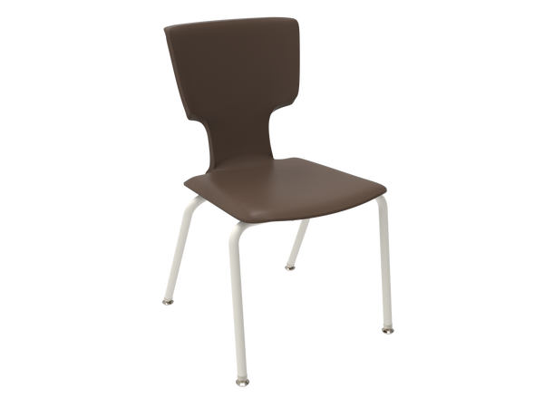
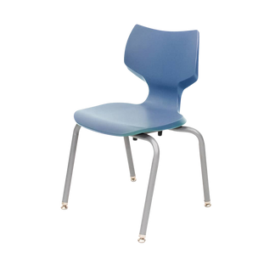
Competitive
Feature | Premier™ Stacking Chair | Smith System Flavors® Stack Chair
Weight Capacity | 18" – 250 lbs; 16"/14" – 175 lbs; 12" – 100 lbs | Up to 250 lbs across all sizes
Seat Heights Available | 12", 14", 16", 18" | 8”, 10", 12", 14", 16", 18"
Shell Material | Polypropylene with flexible back | 100% virgin polypropylene
Frame Construction | 1-1/8" tubular steel with welded brackets | 1" diameter, 14-gauge welded steel frame
Glide Options | Nickel-plated self-leveling nylon; optional felt | Nylon swivel glides; optional felt or steel
Stacking Capacity | 8–10 chairs high | Up to 4 chairs high
Color Options | 15 shell colors; 3 leg finishes (gray, chrome, cream) | 13 standard shell colors; 2 frame colors (chrome, platinum)
Warranty | 10 years | Lifetime on frame; 12 years on shell and glides
Lead Time | Quick turnaround (assembled in USA) | 5 days for standard colors (under 40 units); up to 8 weeks for non-standard colors
Unique Features | Four-sided waterfall edge; molded back with ledge | Torsional flex back; shallow seat pan; integrated handle
Catalog Dealer Price | $73 - $83 | $86 - $118
List Price | $163 - $183 | $125 - $217 (Price List)

Slide 6

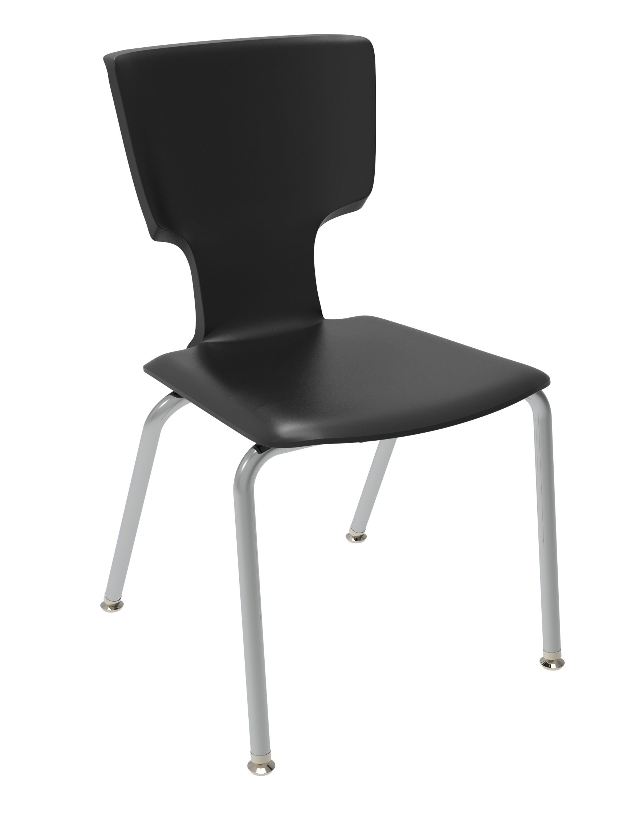
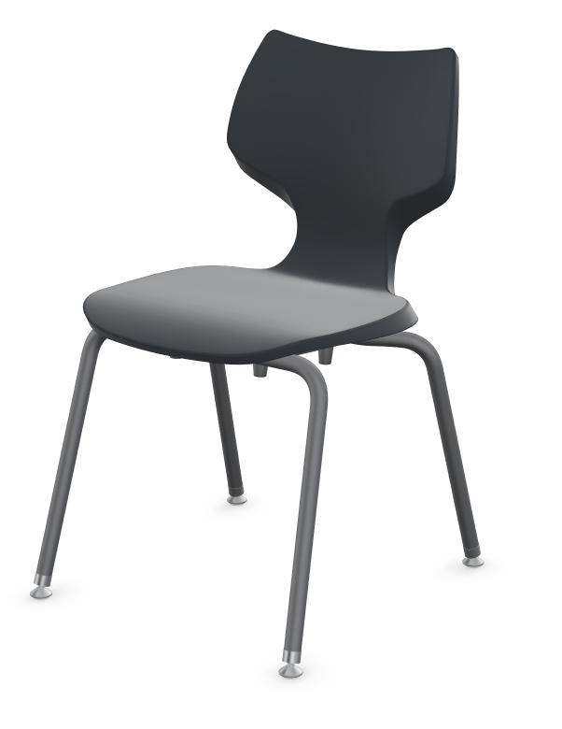

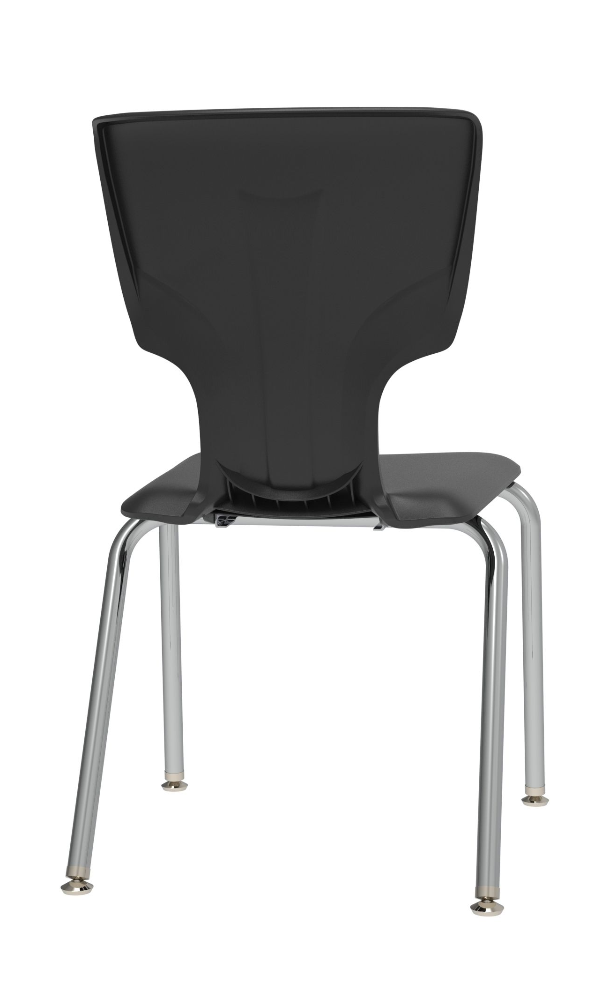
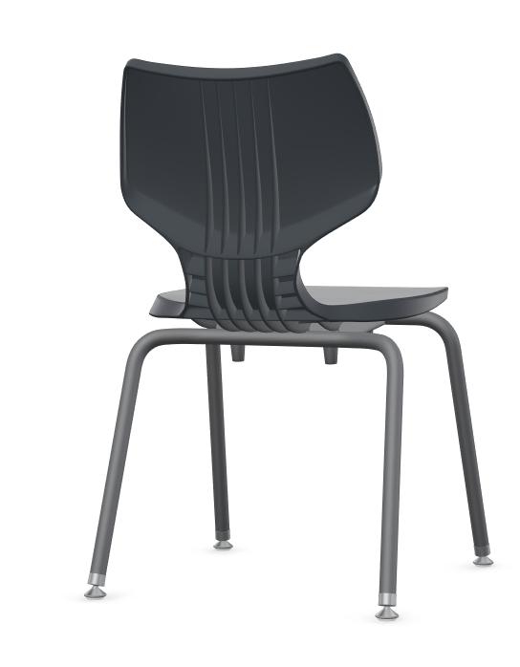
Competitive
Premier™ Stacking Chair
Smith System Flavors® Stack Chair

Slide 7

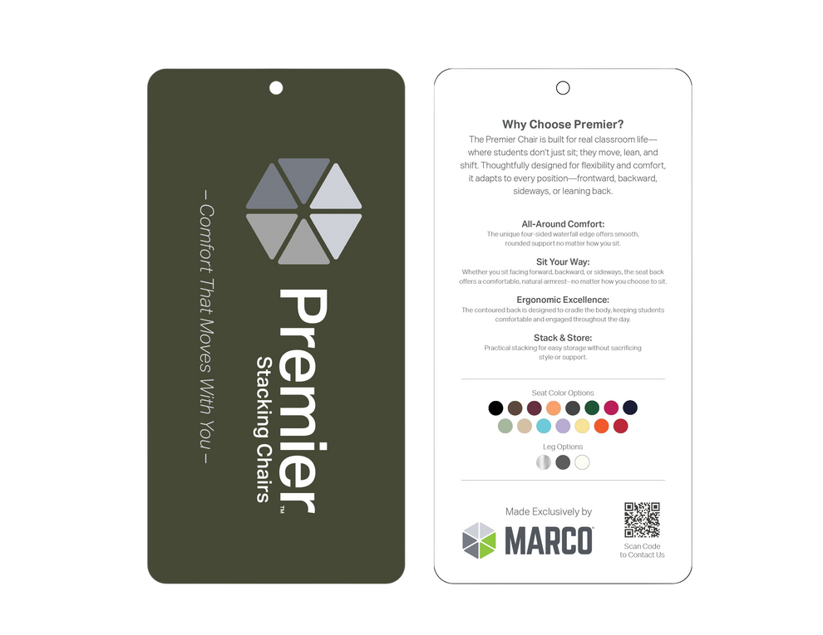

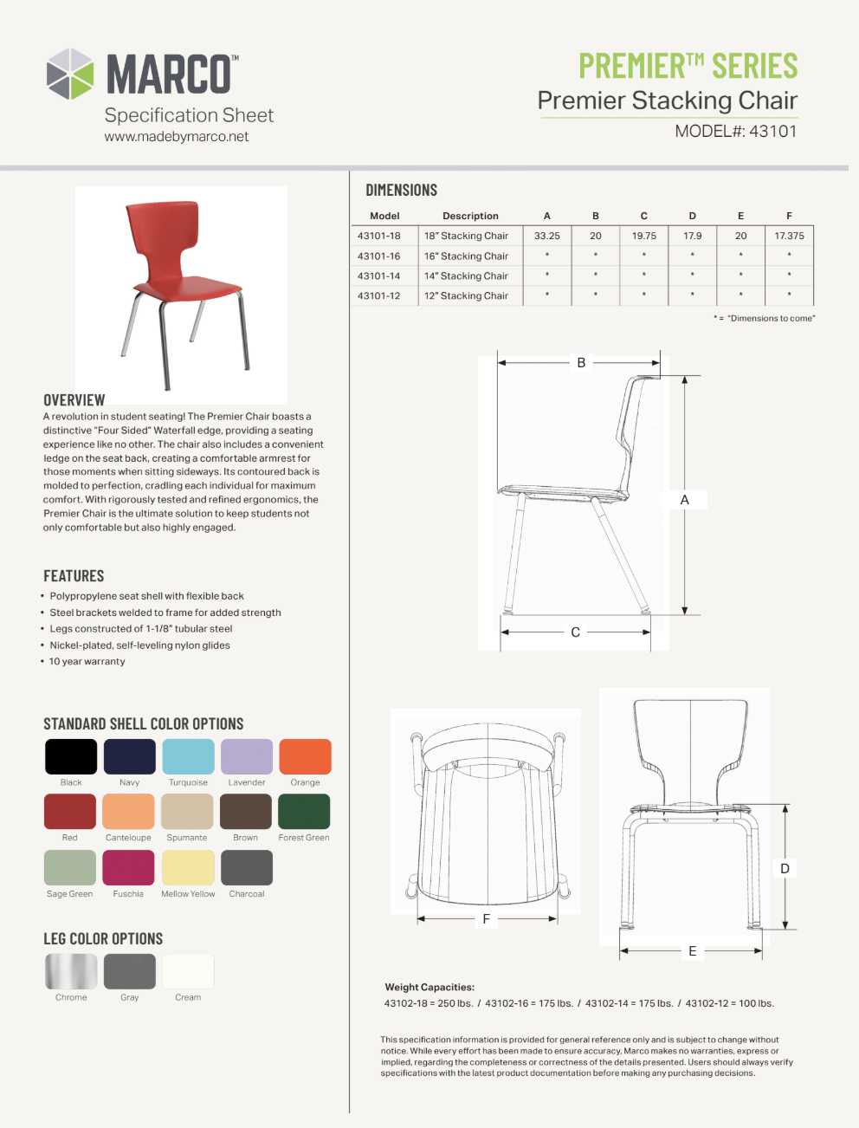
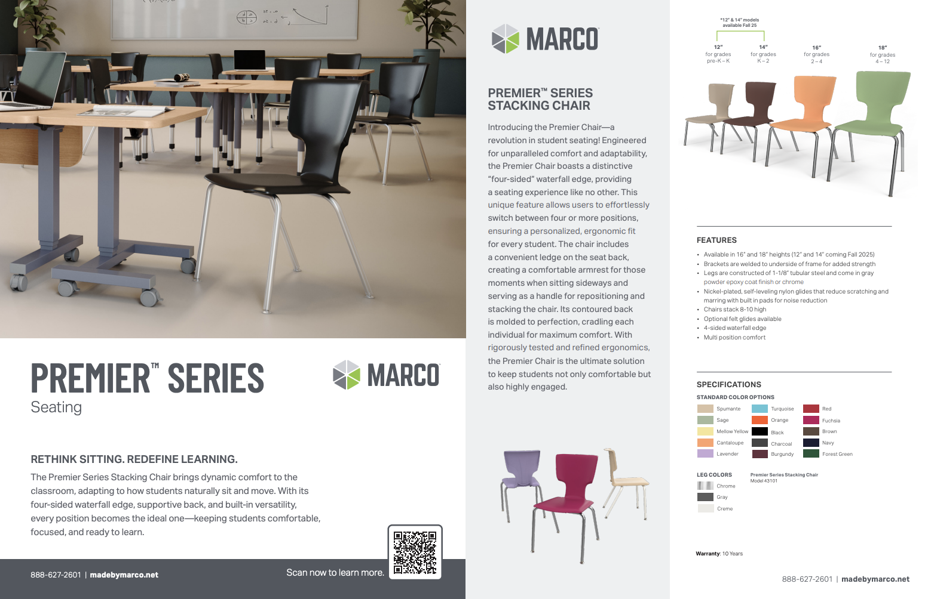
Assets Map
E-CARD
Click circles for links and updates.
SELL SHEET
  E-cards to be sent to key dealers/customers on Tuesday (after Memorial Day)
  Physical chair samples shipping next week
IMAGES
PRODUCT TRACKER
SPEC SHEET

Slide 8
Messaging Themes
Built for Real Classroom Life
“The chair that moves with them.”
Ergonomics Meets Endurance
“All-day comfort meets all-year durability.”
Form Follows Function, Then Surpasses It
“Built to support. Designed to inspire.”
Adaptable Sizes, Lasting Value
“The chair that grows with your students—and your budget.”

Slide 9
Social Campaign
Post #1 – Introduction to Premier
Post #2 – Feature Close-Up
Copy:
Students don’t just sit—they move, lean, shift, and fidget. The Premier Chair is built for every angle of learning.
Thoughtfully engineered for how students really sit.
Built for real classroom life.
#AmericanMade #EducationFurniture #MarcoPremierChair #FlexibleClassrooms
Copy:
Comfort isn’t a feature—it’s the foundation.
With its four-sided waterfall edge and sculpted back, Premier™ supports every learning posture.
Not just a chair. A learning tool.
#ErgonomicDesign #K12Furniture #MarcoGroup #BuiltToLast
Post #3 – Stackability & Value
Copy:
From flexible seating to easy storage.
Premier™ chairs stack 8–10 high, saving time, space, and stress.
Comfort, strength, and smart design—made by Marco.
#SmartStorage #SchoolFurnitureUpgrade #MarcoPremier #StackableChairs

Slide 10
Email Campaign Campaign
Subject Line:
Your Classroom Just Got Smarter: Meet Premier™
Subject Line:
Why Dealers Are Calling This Chair a Game-Changer
Body:
Students aren’t statues. They move, lean, and shift as they learn. The Premier™ Chair from Marco is built to support them—every direction, every posture.
Engineered for ergonomic comfort, with a molded back and unique four-sided waterfall edge, Premier™ helps students stay focused and engaged all day long.
Plus, it stacks up to 10 high, supports up to 250 lbs, and comes in 15 vibrant shell colors—perfect for any learning space.
CTA Button: [Learn More]
Body:
Your projects demand more—more comfort, more durability, and more storage-savvy solutions.
Marco’s new Premier™ Chair is everything your schools need (and more) at a price point that wins bids without sacrificing quality.
Available in 4 sizes with welded steel brackets, ergonomic design, and trusted U.S. manufacturing.
Ask us about quick quoting, stackable inventory, and finish options.
CTA Button: [See More]

