Slide 1
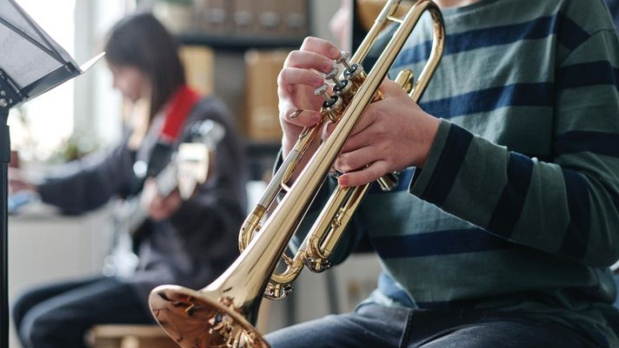

Behind the Music
Designing Safer, Smarter Spaces for Student Success
Notes:
Hello! My name is __________ and thanks for taking the time to join us today.
Welcome to Behind the Music: Designing Safer, Smarter Spaces for Student Success. This course is designed to explore the often-unseen role the physical environment plays in supporting music education. Together, we’ll examine design considerations that influence how music spaces function — for students, educators, and the programs they support.

Slide 2
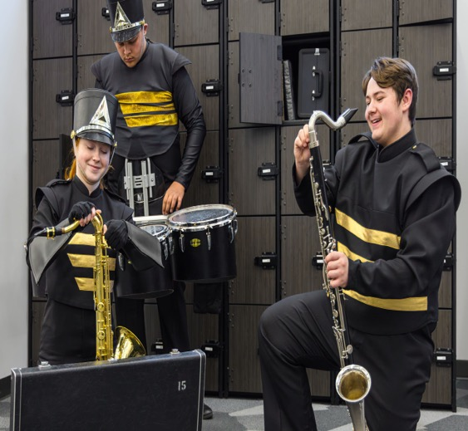
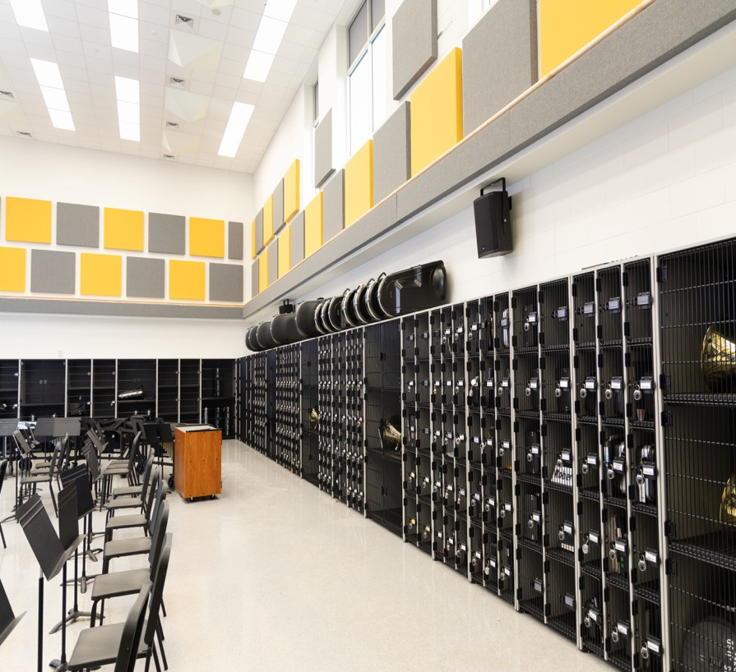
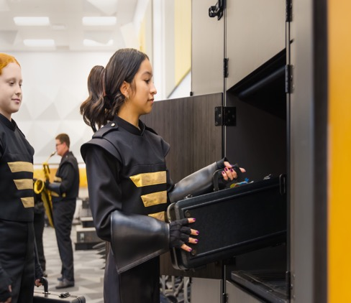
What We’ll
Learn Together
Notes:
Whether you design learning environments or manage them, we all share a goal — helping students perform at their best.
But in music education, there’s often a disconnect between what’s designed and what’s needed.
Too often, the focus goes to surface-level decisions, , while critical details — like storage, accessibility, and flexibility — get pushed to the end of the project. The result? Teachers lose rehearsal time, instruments are damaged, students trip over cases, and valuable square footage gets underused.
In Behind the Music, we’ll explore how thoughtful, intentional design can change the rhythm of a music program — improving safety, performance, and long-term success.

Slide 3

Areas of Focus
Learning Objectives:
Student Performance, Focus + Classroom Management
Safety + Ergonomic Implications
Financial + Operational Impact
Design Strategies for Future-Proofing
Construction Principles for Long-Term Performance
.
Notes:
So, in today’s CEU Behind the Music, I hope that we accomplish the following learning objectives:
1. Analyze how storage and organization directly impact student performance, focus, and classroom management in music spaces.
2. Evaluate the safety and ergonomic implications of poor vs. well-designed storage solutions.
3. Assess the financial and operational benefits of flexible, long-lasting storage systems for school districts and facility managers.
4. Apply design strategies for future proofing that align with evolving music program needs and inclusive learning environments.
5. Identify construction principles that contribute to long-term performance, organization, and reliability in high-use music spaces.

Slide 4
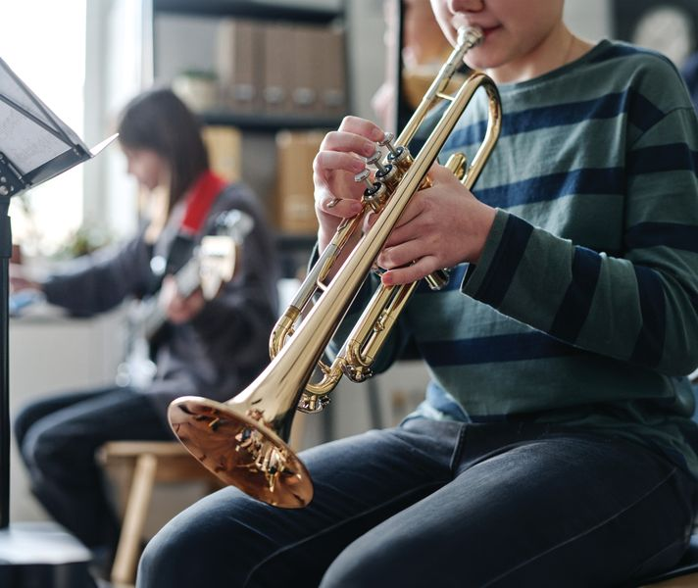
Student Performance, Focus + Classroom Management
Notes:
Let’s start with our first objective – do a deep dive on how space and organization influences the student experience.

Slide 5
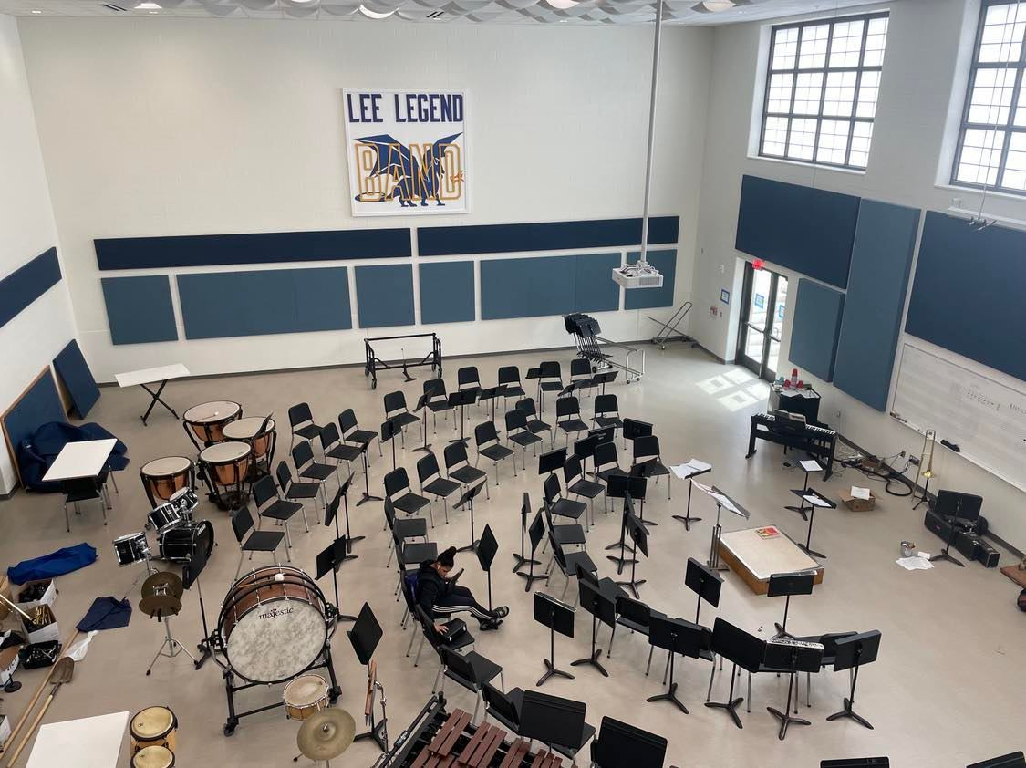
Student Performance, Focus + Classroom Management
Student Performance Starts with the Environment
Music spaces are highly stimulating by nature
Organization plays a critical role in focus and behavior
Storage influences how students move, think, and perform
Notes:
Music rooms are unlike traditional classrooms. They’re louder, more active, and filled with large, shared equipment. Because of that, students rely more heavily on environmental cues to stay focused and organized.
And, before we talk about safety or cost, we need to understand how the physical environment directly shapes student behavior, attention, and performance.
Band rooms are some of the most cognitively demanding learning environments in a school. Students are processing sound, visual cues, physical movement, peer coordination, and instructor direction — all at the same time.

Slide 6
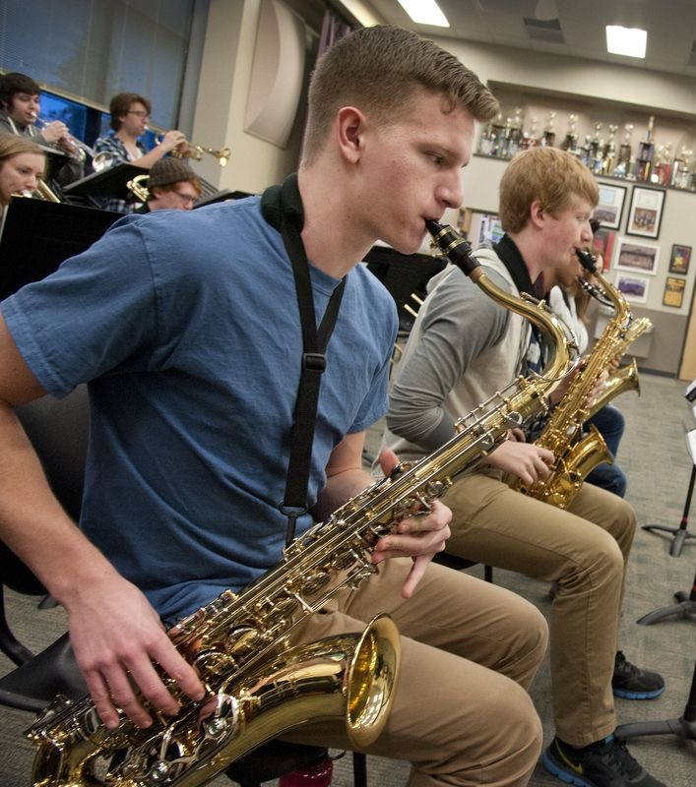
Student Performance, Focus + Classroom Management
25%
physical learning environment can account for up to 25% of the variation in student outcomes over the course of a year.
Notes:
Research shows that the physical learning environment can account for up to 25% of the variation in student outcomes over the course of a year. That impact becomes even more pronounced in high-stimulus spaces like music rooms, where students are already managing a higher cognitive load.

Slide 7
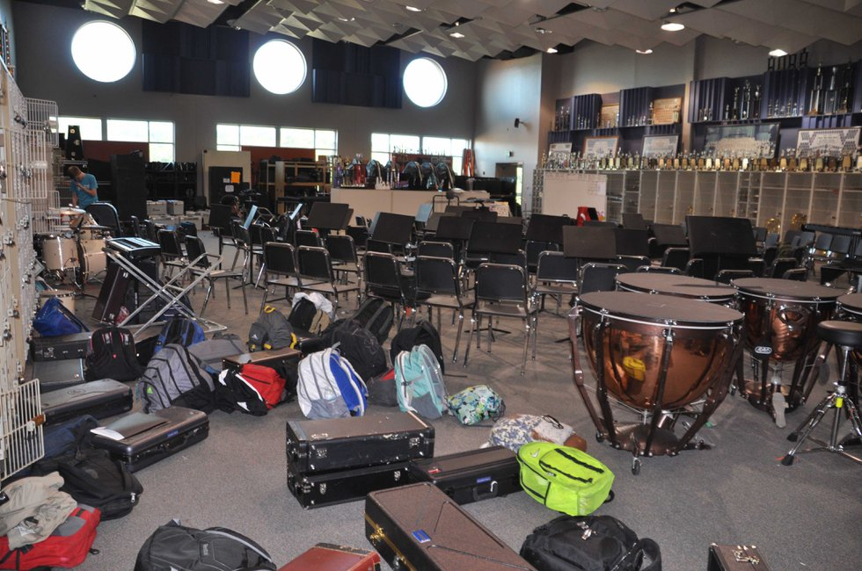
Student Performance, Focus + Classroom Management
Notes:
In band spaces, disorganization doesn’t just look messy — it actively competes for attention. Open cases, crowded walls, scattered storage, and unclear instrument placement create visual noise that pulls focus away from listening, timing, and technique.

Slide 8
Student Performance, Focus + Classroom Management
85%
of students experience disorganized environments as stressful
90%
report feeling more focused in organized spaces.
Notes:
Studies on workspace organization show that 85% of students experience disorganized environments as stressful, and nearly 90% report feeling more focused in organized spaces. In music education, that stress often shows up as behavioral issues, slow transitions, or students disengaging before rehearsal even begins.

Slide 9
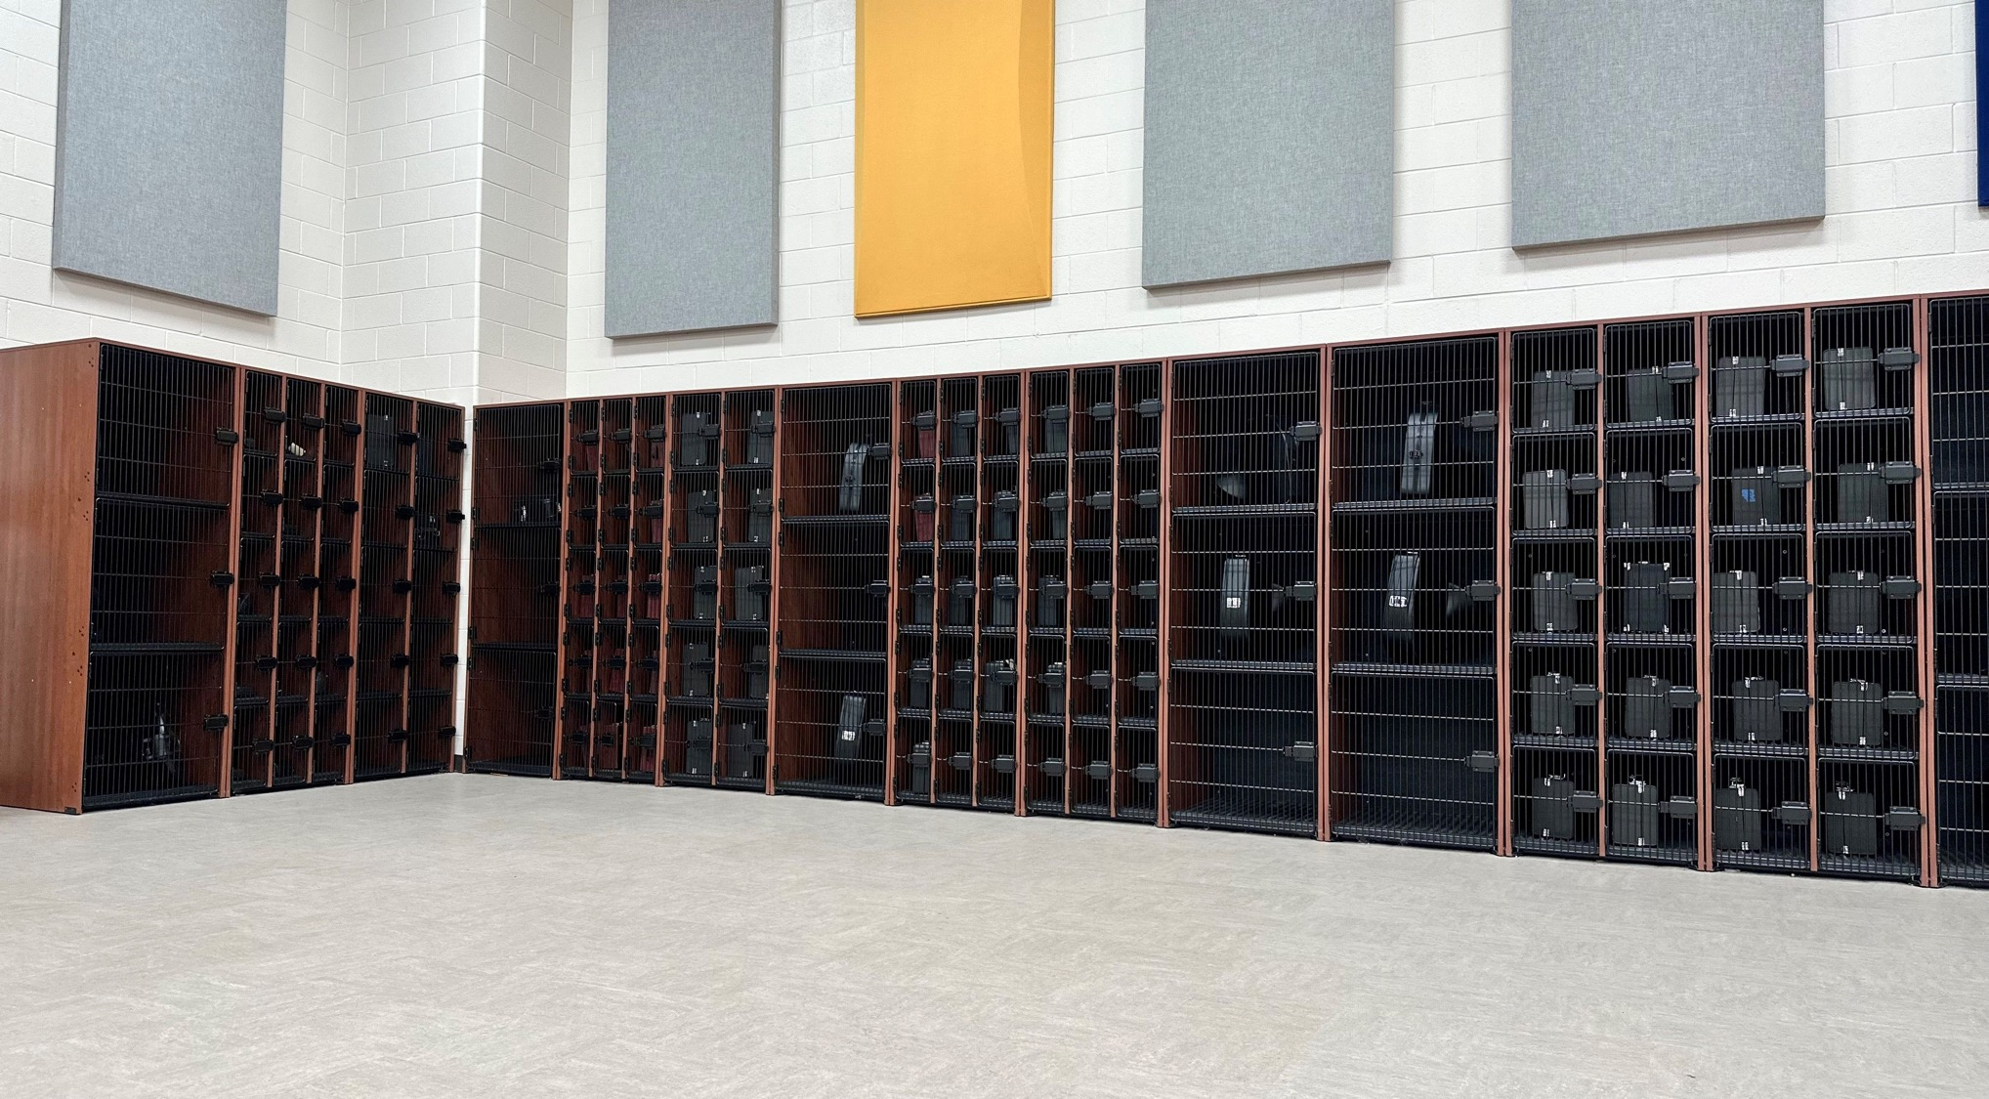
Student Performance, Focus + Classroom Management
When instruments have clear homes and visual clutter is minimized — students settle more quickly. Rehearsals start faster.
Notes:
When storage is intentional — when instruments have clear homes, pathways are predictable, and visual clutter is minimized — students settle more quickly. Rehearsals start faster. Teachers spend less time managing logistics and more time teaching music. In other words, organization doesn’t limit creativity in band rooms — it supports it. A well-structured environment frees students’ mental energy so they can focus on sound, collaboration, and performance.

Slide 10
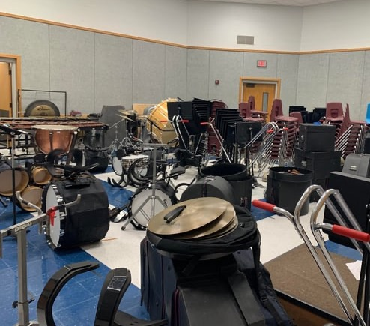
Student Performance, Focus + Classroom Management
Student Performance, Focus + Classroom Management
THE STRESS OF DISORGANIZATION
When Spaces Feel Chaotic, Students Feel It Too
Visual clutter increases stress and distraction
Disorganization slows transitions and setup
Notes:
In disorganized music rooms, students are often searching for instruments, navigating clutter, or waiting while others figure things out. That friction creates low-level stress — and over time, that stress impacts engagement and behavior. The more chaotic the space feels, the harder it is for students to mentally settle into learning.

Slide 11
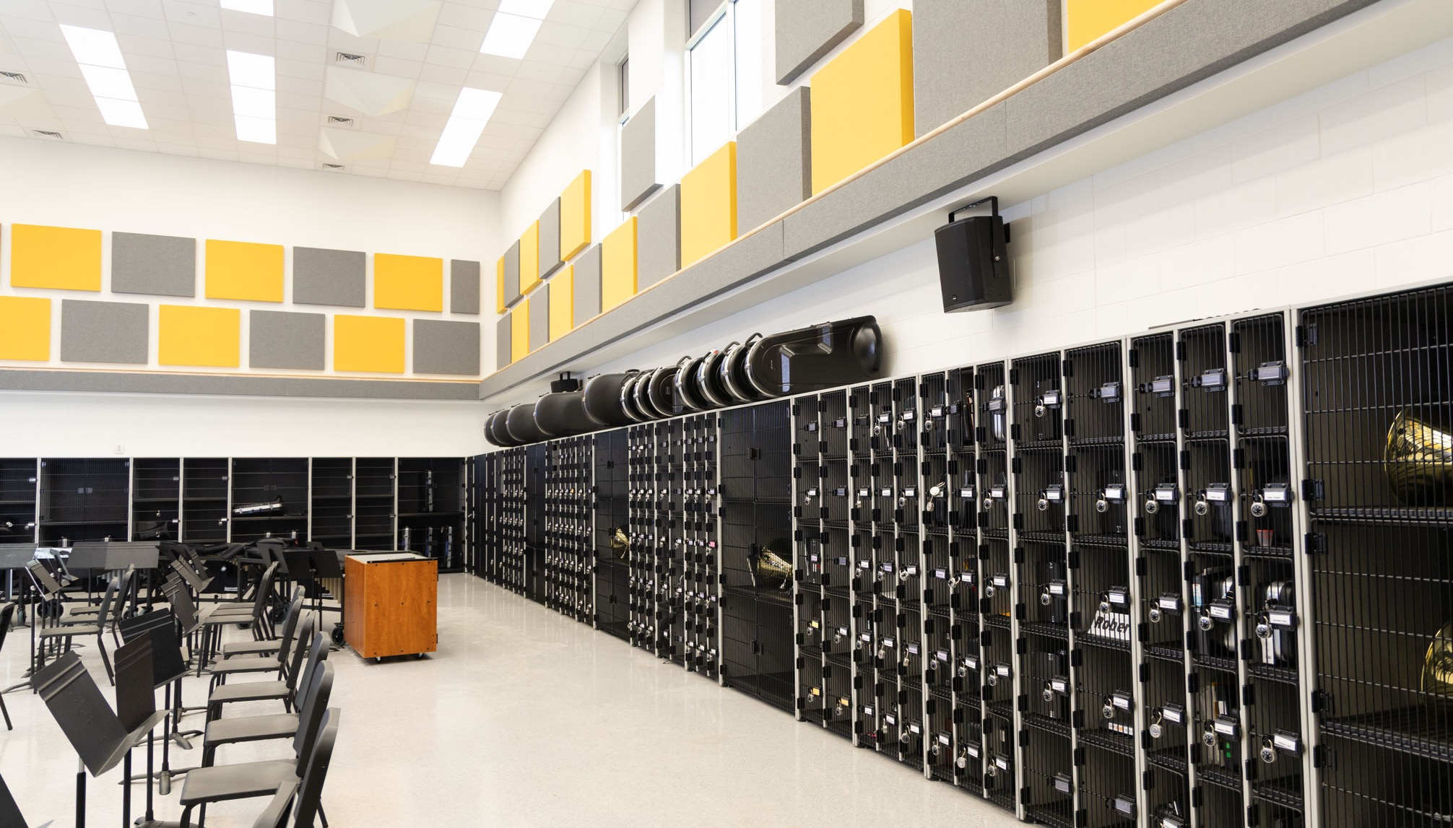
Student Performance, Focus + Classroom Management
Clutter reduces working memory + focus
“Visual clutter doesn’t just look messy — it taxes the brain’s ability to maintain focus and process information.”
- Journal of Experimental Psychology
Notes:
Research in cognitive psychology shows that visual clutter competes for mental resources. Environments with high levels of irrelevant visual information draw attention away from task-relevant cues, reducing working memory capacity and focus. This effect is especially pronounced in learning settings where students are trying to process new information.
“Visual clutter doesn’t just look messy — it taxes the brain’s ability to maintain focus and process information.”

Slide 12
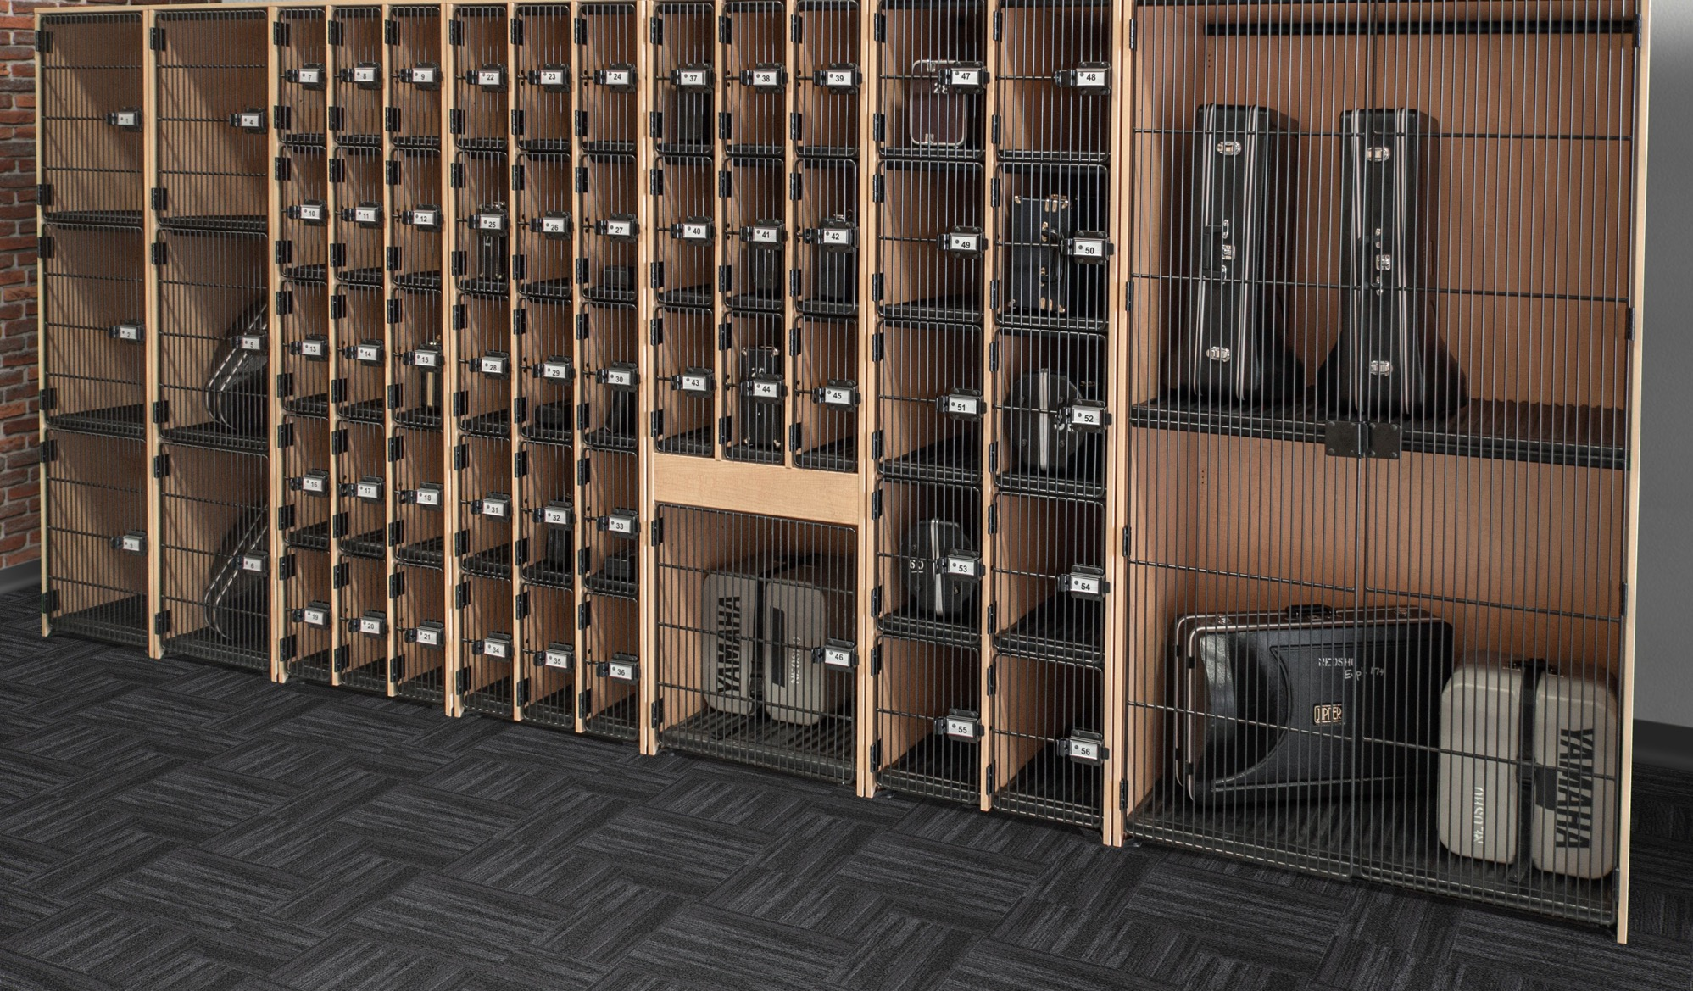
Student Performance, Focus + Classroom Management
Visual Order & Cognitive Performance
Why Visual Order Matters for Learning
The brain processes visual information constantly
Clutter competes for attention
Order supports quicker focus and task readiness
Notes:
In music spaces — where students already juggle sound, movement, and instruction — excess visual noise makes it harder to focus. When storage is clearly defined and visually consistent, students know where things belong and what’s expected, allowing them to shift faster into learning mode.

Slide 13
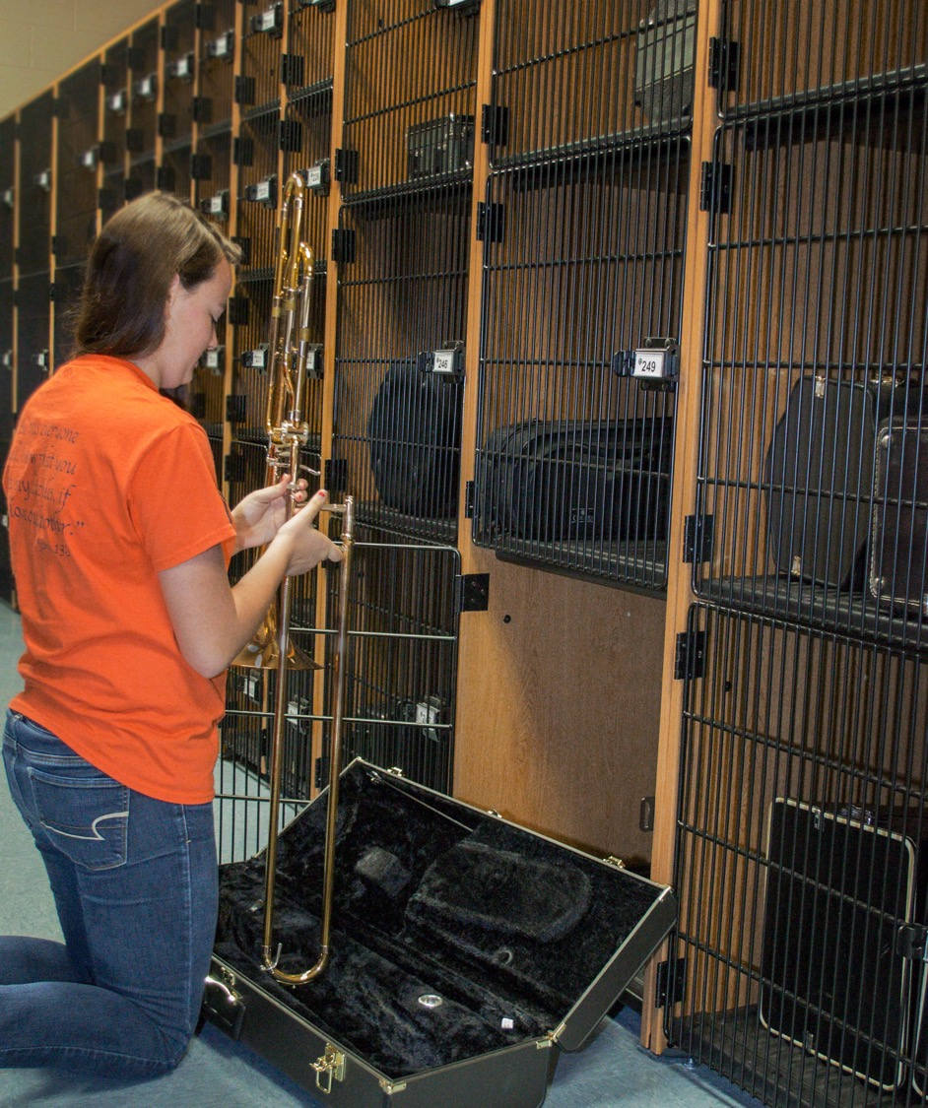
Student Performance, Focus + Classroom Management
Storage as a Classroom Management Tool
Storage Is Not Neutral — It Guides Behavior
Notes:
Well-designed storage quietly reinforces classroom rules. When every instrument has a visible, consistent place, students take ownership — and teachers spend less time correcting behavior. This isn’t about control; it’s about clarity. The environment communicates expectations before a teacher ever has to.

Slide 14
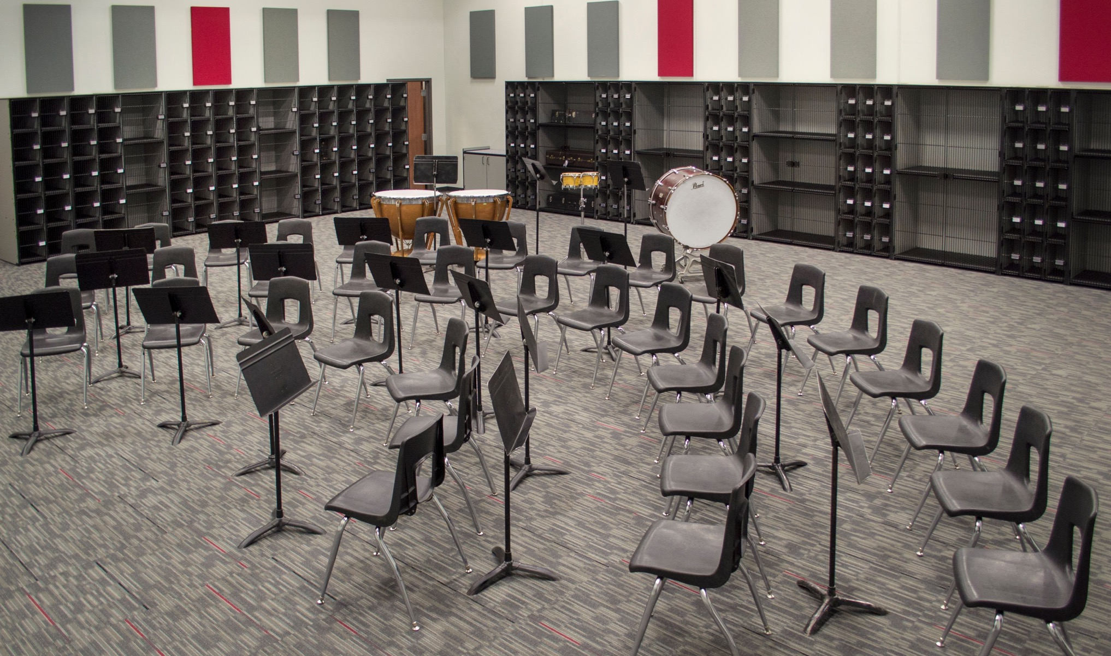
Student Performance, Focus + Classroom Management
TIme on Task = Time Making Music
Less Searching. More Playing.
Notes:
Think of it this way… In a 45-minute class, losing five minutes to disorganization is significant. Multiply that across periods, weeks, and semesters — and the instructional loss becomes real. Organized storage supports efficiency, which directly translates to more time for learning, practice, and creativity.

Slide 15
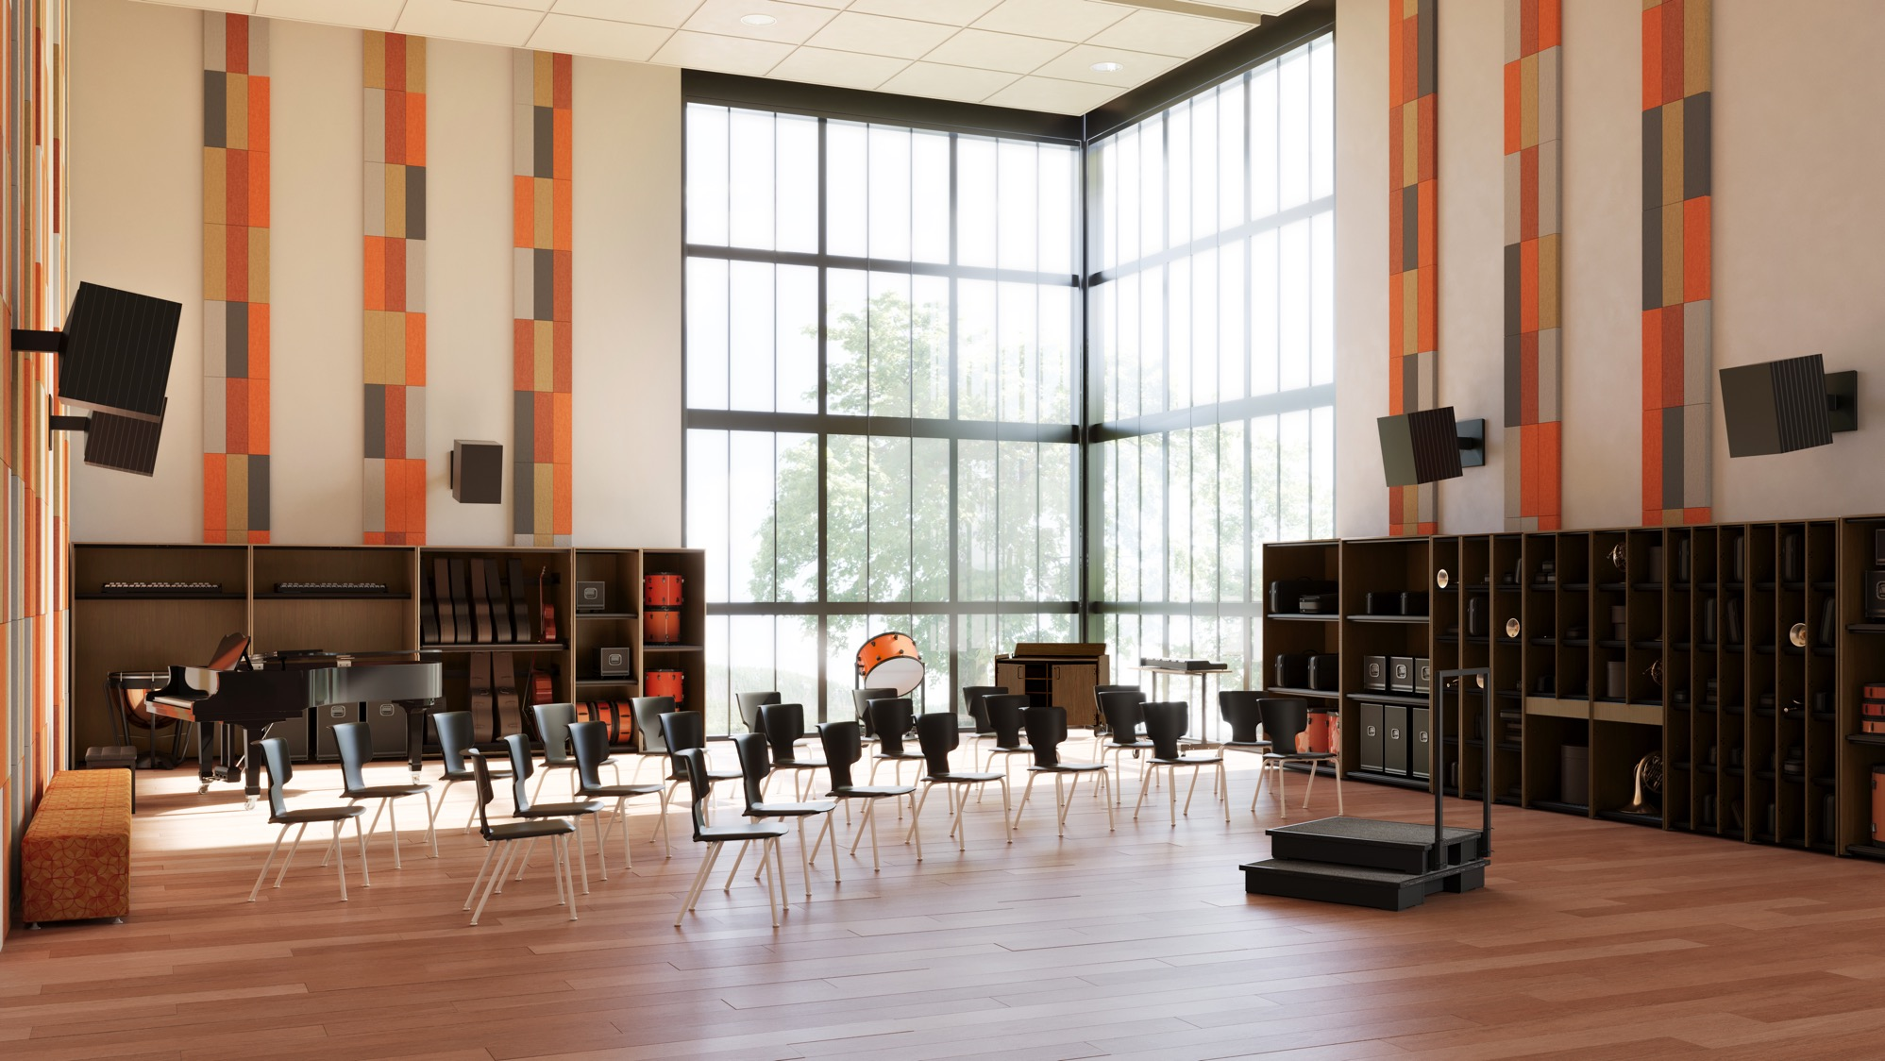
Student Performance, Focus + Classroom Management
“Students understand that professional performance happens in spaces that are clean and organized, and that it is their responsibility to maintain this space.” — Eugene Butler, Director of Bands at Smiths Station High School
Notes:
And Here’s What one Music Educator Says about environment and performance
“Students understand that professional performance happens in spaces that are clean and organized, and that it is their responsibility to maintain this space.”
This insight from a high school band director gets right to the heart of what we’ve been discussing. When students see their rehearsal space as professional — clean, organized, and intentional — they carry themselves differently. They approach rehearsal more seriously, take better care of their instruments, and act with ownership of their learning environment. What Butler is really describing is how environment becomes a behavior cue — a signal that music making here matters, and that students are participants in making it successful.

Slide 16
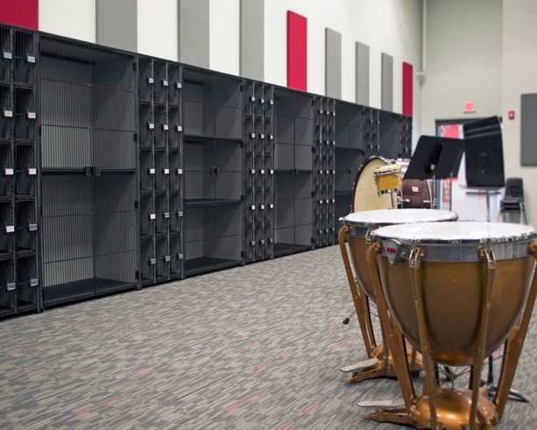
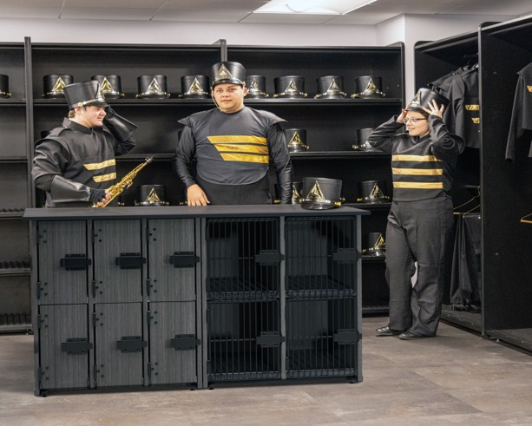

Student Performance, Focus + Classroom Management
Environment Reinforces Behavior
Structure Supports Creativity
Storage is Part of A Learning System
Notes:
So, before a teacher speaks, the environment is already communicating expectations.
Environment reinforces behavior. Organized music spaces communicate expectations before instruction begins, helping students transition faster, stay focused, and take responsibility for their instruments.
Structure supports creativity. When storage and layout reduce distraction and stress, students are better able to listen, collaborate, and perform—allowing creativity to thrive within a clear framework.
Storage is part of the learning system. Thoughtful storage design isn’t just about keeping things tidy; it actively supports classroom management, instructional flow, and long-term program success.
Now that we’ve looked at how organization affects focus and behavior, let’s talk about what happens when storage isn’t designed with students in mind — especially when it comes to safety and ergonomics.”

Slide 17
Safety + Ergonomic Implications
Notes:
Music spaces are active, high-movement environments. How instruments are stored, accessed, and transported has a direct impact on student safety, physical strain, and daily classroom flow.

Slide 18
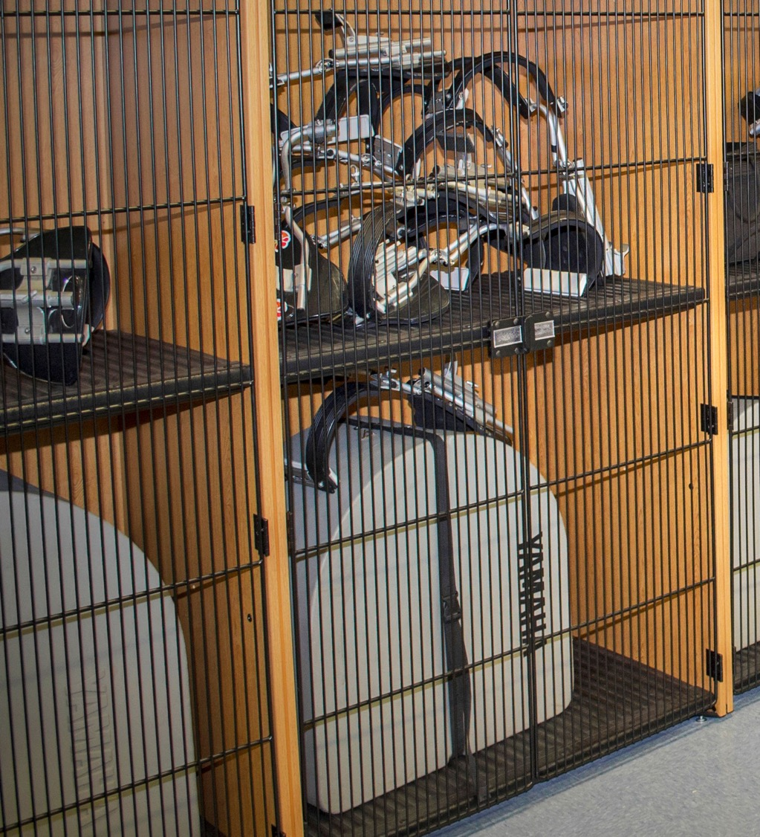
Safety + Ergonomic Implications
SAFETY IS DESIGNED, NOT ASSUMED
When Storage Fails, Safety Is at Risk
Notes:
Students come in all sizes, especially in middle and high school band programs where physical development varies widely. Music spaces are physically demanding environments. Students routinely lift awkward, heavy instruments and navigate crowded rooms. When storage is poorly designed—too high, too low, or poorly located—it introduces unnecessary risk. Safety in music rooms isn’t just about rules or supervision; it’s embedded in how the space is designed and how equipment is accessed every day.

Slide 19
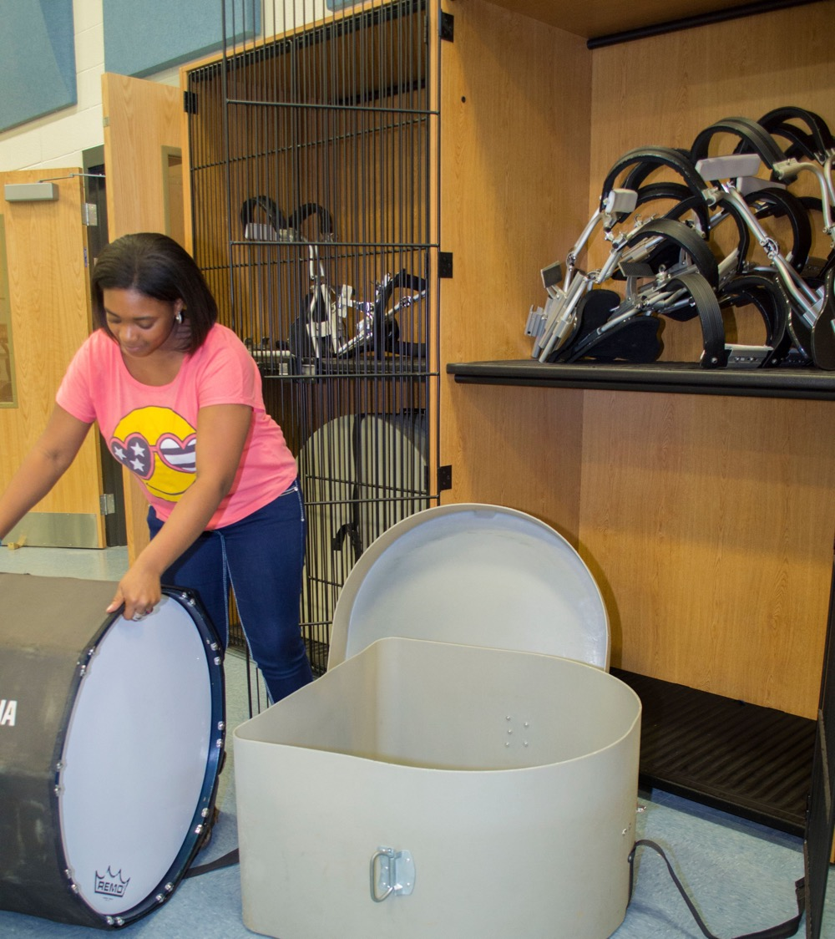
Safety + Ergonomic Implications
WEIGHT, BALANCE + INSTRUMENT CONTROL
Managing Heavy, Awkward Equipment
Large instruments shift balance and posture
Poor storage increases dropping and tipping risk
Stable systems support safe handling
Notes:
Large instruments shift balance and posture, especially for younger students. Most safety issues happen during transitions—lifting, turning, and returning instruments. When storage is unstable or poorly positioned, students compensate by overreaching or rushing, which increases drop and tip risk.
Stable, well-designed systems give students predictable support, improving control and reducing both injury and instrument damage.”

Slide 20
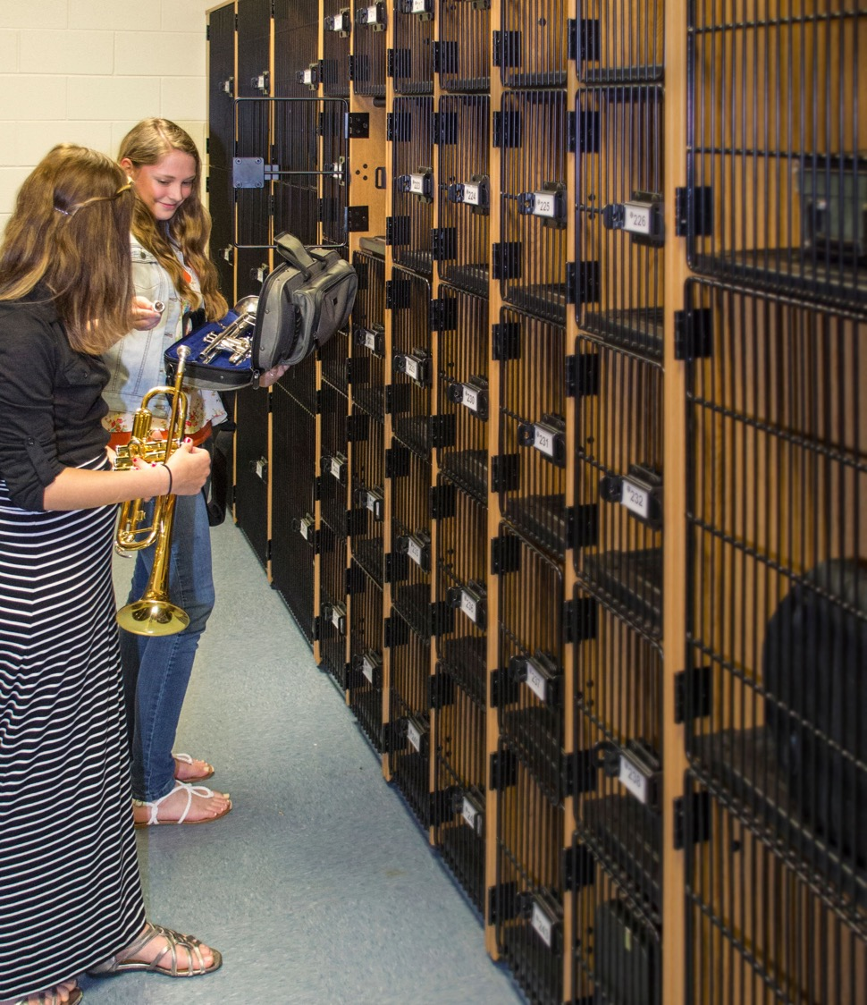
Safety + Ergonomic Implications
PROTECTING INSTRUMENTS IS
PROTECTING STUDENTS
Notes:
Instruments are not only expensive—they can become safety hazards when stored improperly. Cases stacked on the floor, unstable shelving, or unsecured racks increase the risk of tipping and collisions. Well-designed storage stabilizes instruments, protects them from damage, and reduces the chance of accidents—protecting both students and school investments.

Slide 21
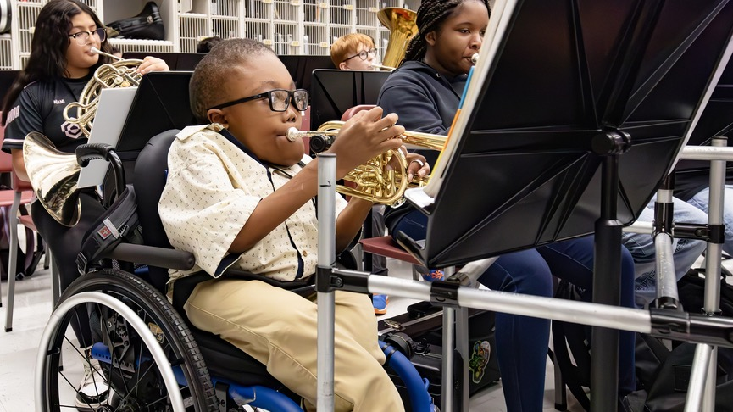
Safety + Ergonomic Implications
ADA + INCLUSIVE ACCESS IN MUSIC SPACES
Accessibility Is a Design Responsibility
Storage must be reachable for all students
Clear pathways support mobility and safety
Inclusive design benefits the entire program
Notes:
ADA considerations in music rooms go beyond clearances—they affect whether students can participate independently and safely. Storage that is unreachable or pathways that are cluttered create barriers for students with mobility challenges. Inclusive storage design ensures all students can access instruments with dignity, reinforcing equity and independence while improving overall room safety.

Slide 22
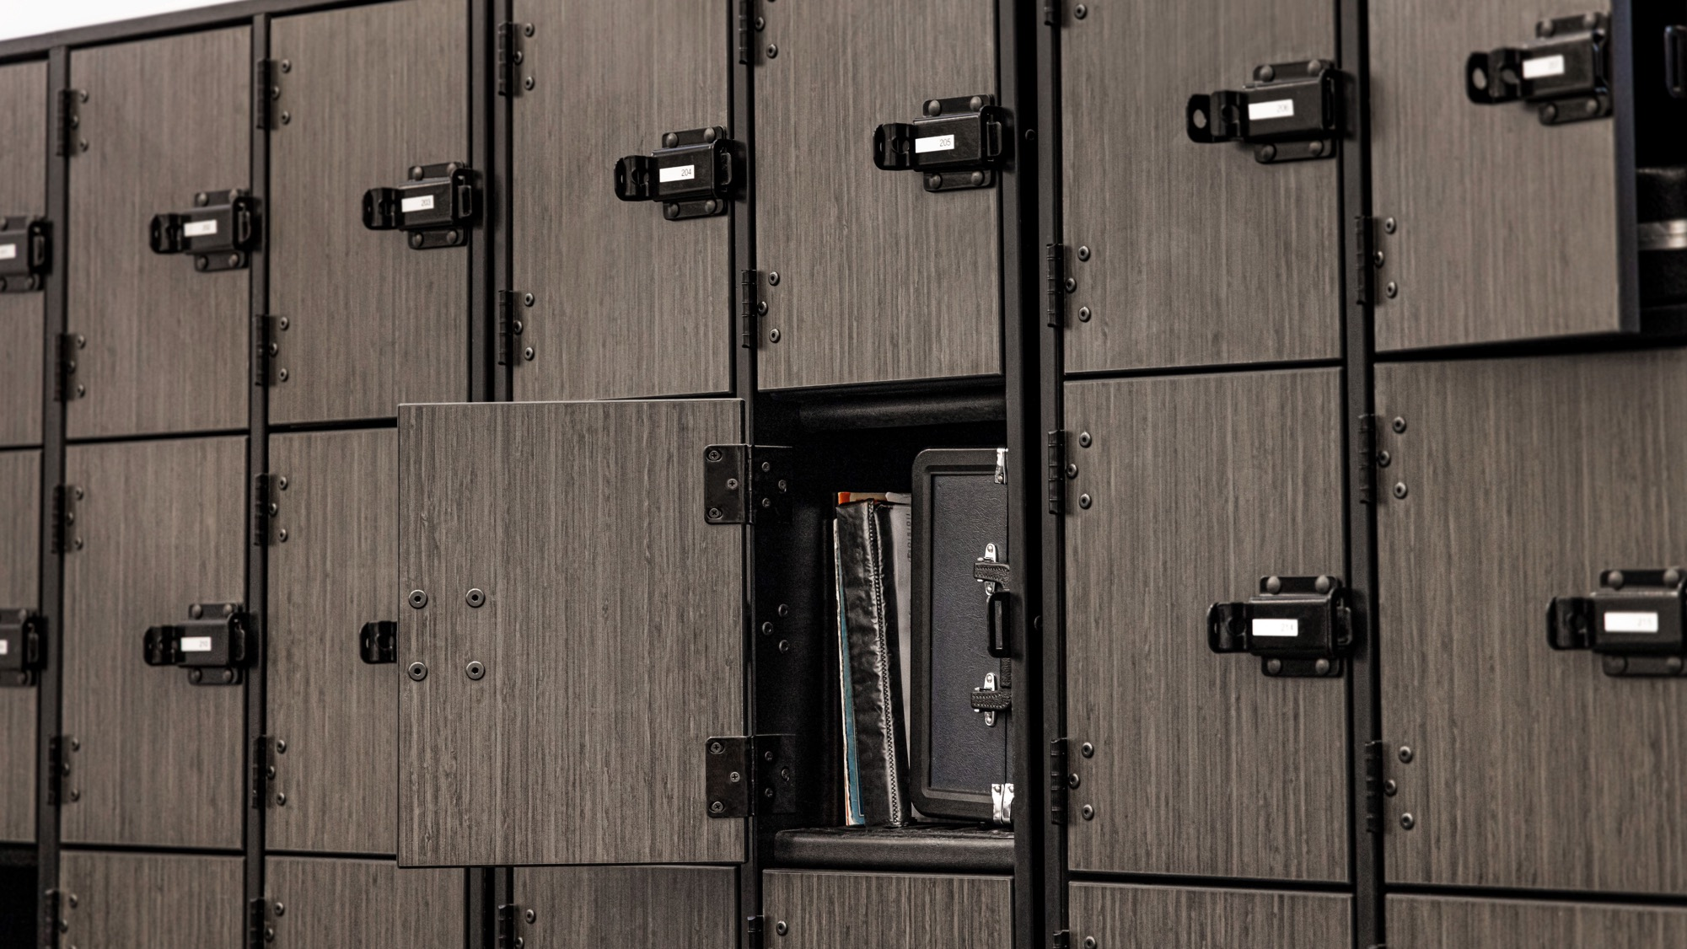
Safety + Ergonomic Implications
LONG-TERM RISK + PROGRAM PROTECTION
When storage supports safety, it doesn’t just prevent injuries — it protects the program itself.
Notes:
Safety isn’t static — it changes as equipment ages. Flimsy or worn storage systems become unstable, increasing the chance of tipping, breakage, or injury. Durable, well-engineered storage protects students and the program long after installation.
When storage supports safety, it doesn’t just prevent injuries — it protects the program itself. Next, we’ll look at how those same decisions affect operational efficiency and long-term cost.

Slide 23
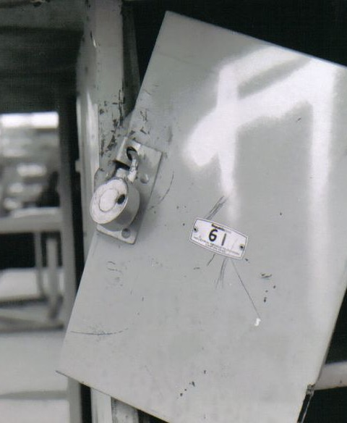
Financial + Operational Impact
Disorganization is often a system failure, not a behavior issue.
Notes:
This section starts with a critical distinction: disorganization is often a system failure, not a behavior issue. When storage isn’t built for daily, high-impact use, it degrades. Shelves sag. Hardware loosens. Alignment shifts. As construction breaks down, organization becomes harder to maintain — and operational inefficiencies follow.

Slide 24
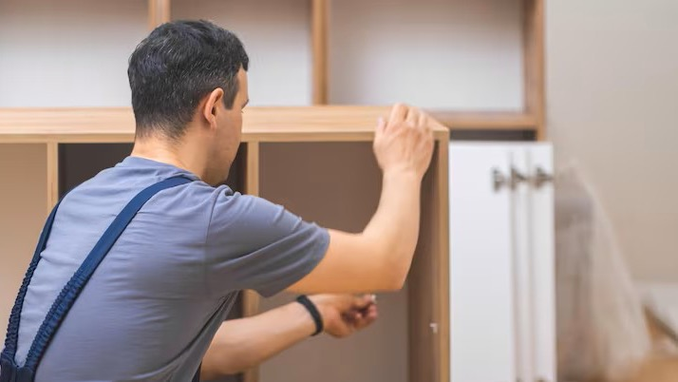
Financial + Operational Impact
MAINTENANCE AS A LONG-TERM COST DRIVER
Maintenance Is the Real Operational Expense
Frequent repairs strain facilities teams
Reactive maintenance replaces planned upkeep
Labor costs accumulate quietly over time
Notes:
In high-use environments like band rooms, maintenance is the most immediate financial signal of poor construction. Facilities teams are called in repeatedly to tighten, adjust, or stabilize systems that weren’t engineered for constant use. Those labor hours compound year after year — often exceeding the initial cost difference between systems.

Slide 25
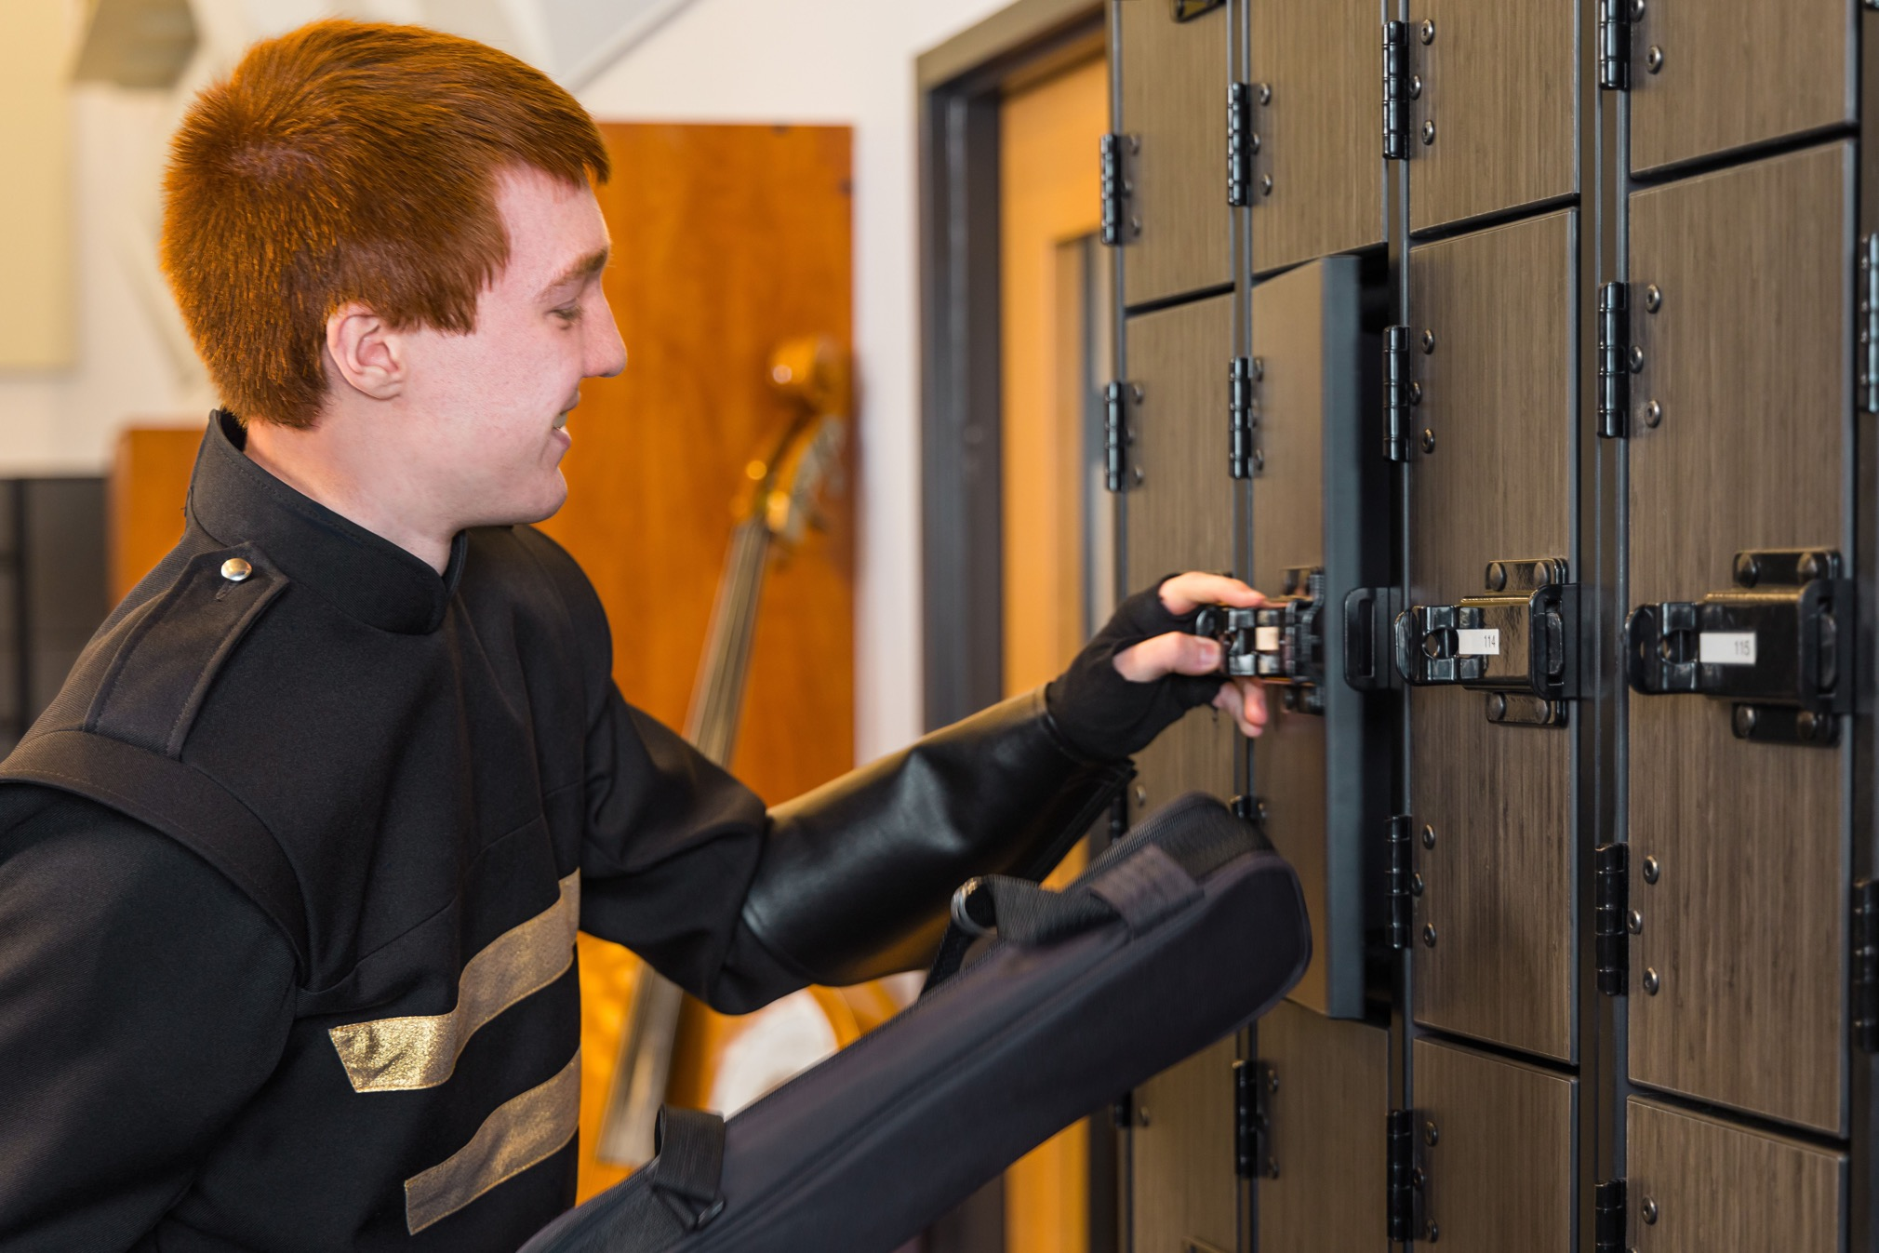
Financial + Operational Impact
PROTECTING CAPITAL ASSETS: INSTRUMENTS
Storage Construction Protects Expensive Instruments
Notes:
Instruments are among the most expensive assets in a music program. When storage systems lose alignment or structural integrity, instruments no longer fit as intended — increasing wear, impact, and damage. Well-built storage preserves both organization and asset life, reducing repair and replacement expenditures.

Slide 26
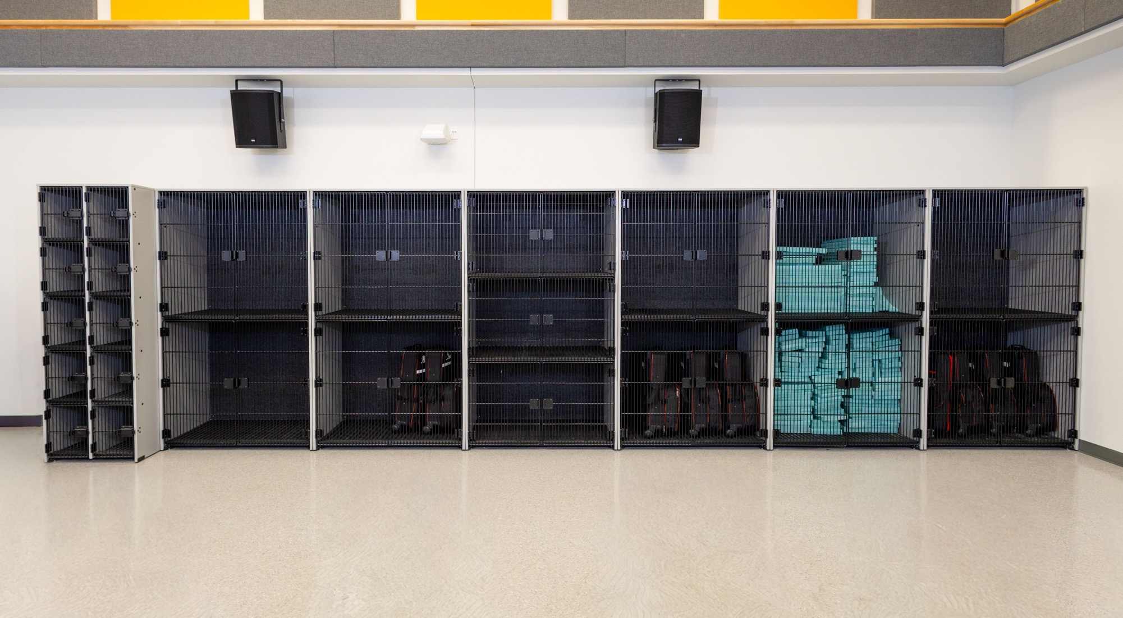
Financial + Operational Impact
FLEXIBILITY THAT PRESERVES INVESTMENT
Adaptability Reduces Future Capital Spending
Notes:
Music programs change — enrollment grows, instrumentation shifts, spaces are shared. Storage systems that are rigid or single-purpose become obsolete quickly. Flexible, modular construction allows districts to adapt layouts without replacing entire systems, preserving capital budgets

Slide 27
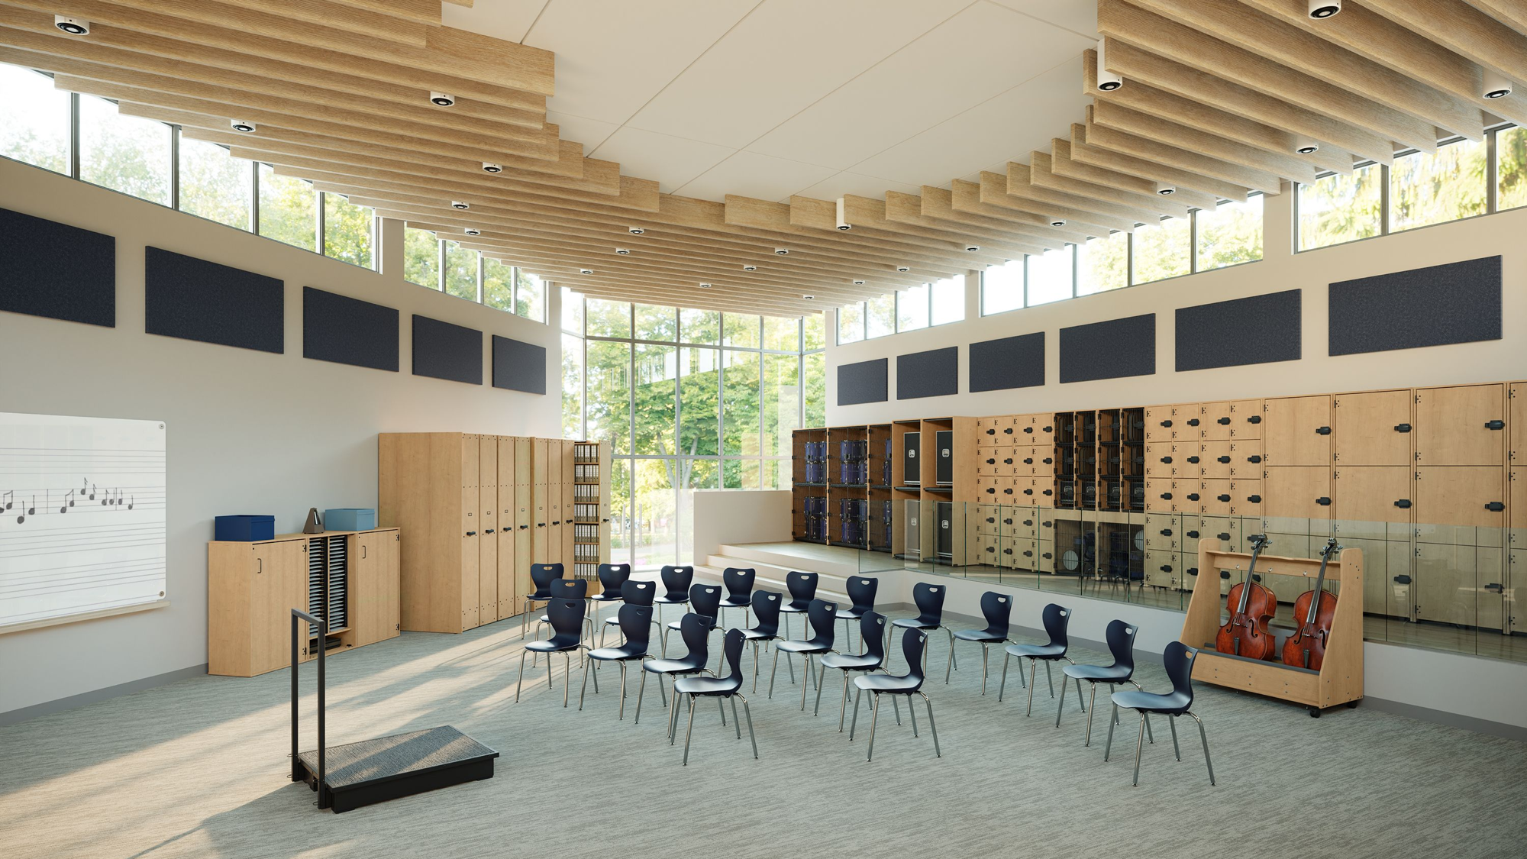
Financial + Operational Impact
MEASURING ROI OVER THE LIFE OF A PROGRAM
10-15%
The condition and performance of the physical environment can account for 10–15% of variation in student outcomes
Notes:
So how do we measure the investment?
Research on school facilities shows that the condition and performance of the physical environment can account for 10–15% of variation in student outcomes. That tells us environment quality isn’t incidental — it has real operational and educational impact.
In band rooms, storage systems are part of that environment. When construction holds up over time, organization stays intact. When organization stays intact, maintenance demands decrease, instrument damage is reduced, and daily operations run more efficiently. Well-built, flexible systems avoid early replacement and reduce ongoing repair labor. That consistency is where true ROI lives — not in upfront savings, but in avoided costs, sustained performance, and long-term reliability.
The most cost-effective storage system is the one that keeps working — year after year.”

Slide 28
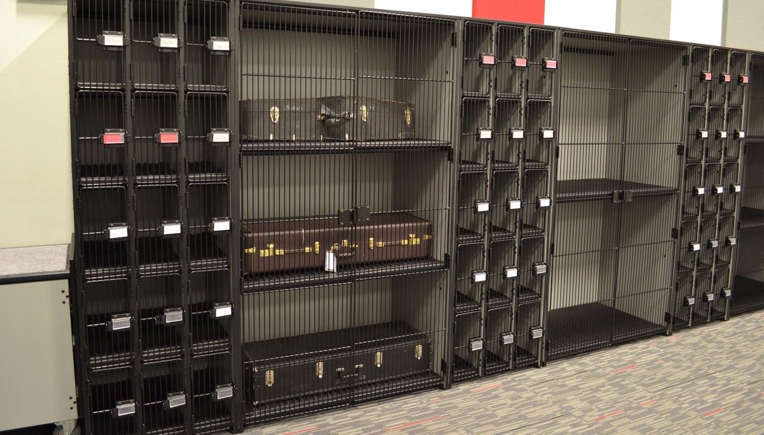
Financial + Operational Impact
WHEN STORAGE PERFORMS, PROGRAMS PERFORM
Preserve Organization
Reduce Maintenance
Safeguards instruments
Performance Delivers ROI
Notes:
Financial and operational success in music spaces doesn’t come from short-term decisions — it comes from systems that continue to perform year after year. When storage is built to last, organization holds. When organization holds, maintenance demands decrease, instruments are protected, and daily operations run more smoothly. That consistency is where real value is created — not just in cost savings, but in reliability, safety, and program longevity.
In band rooms, storage that performs isn’t an expense. It’s infrastructure.

Slide 29
Design Strategies for Future Proofing
Notes:
Understanding the long-term cost and operational impact of storage is critical. The next step is applying those insights to design music spaces that can adapt as programs change.

Slide 30
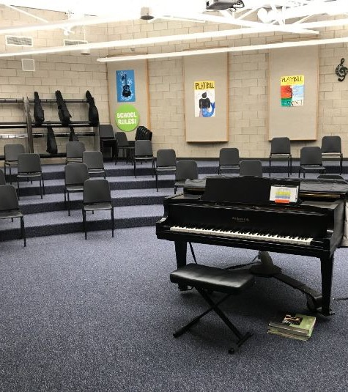
Design Strategies for Future Proofing
WHY FUTURE PROOFING MATTERS IN MUSIC SPACES
Music Programs Change. Spaces Must Keep Up.
Notes:
Music programs are dynamic. Enrollment grows or contracts, instrumentation changes, and rooms are often shared with choir, general music, or performance prep. Future-proofing is about designing storage and layouts that can absorb change without requiring renovation or replacement.

Slide 31
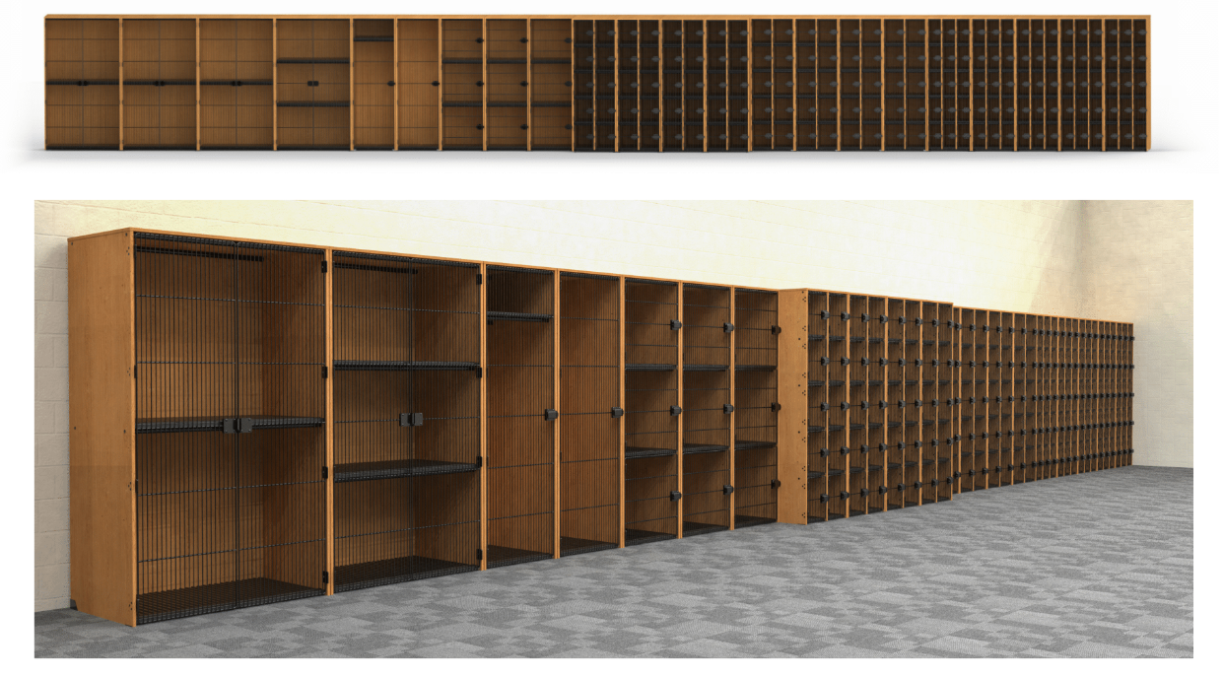
Design Strategies for Future Proofing
MODULAR SYSTEMS THAT GROW WITH PROGRAMS
Designing for Expansion, Not Replacement
Add or reconfigure components over time
Maintain consistent organization as programs grow
Avoid starting over as needs change
Notes:
Modular storage systems allow schools to scale up or adjust layouts without disrupting the entire room.Instead of replacing storage when programs expand, districts can build onto existing systems — preserving investment while maintaining organization and flow.

Slide 32
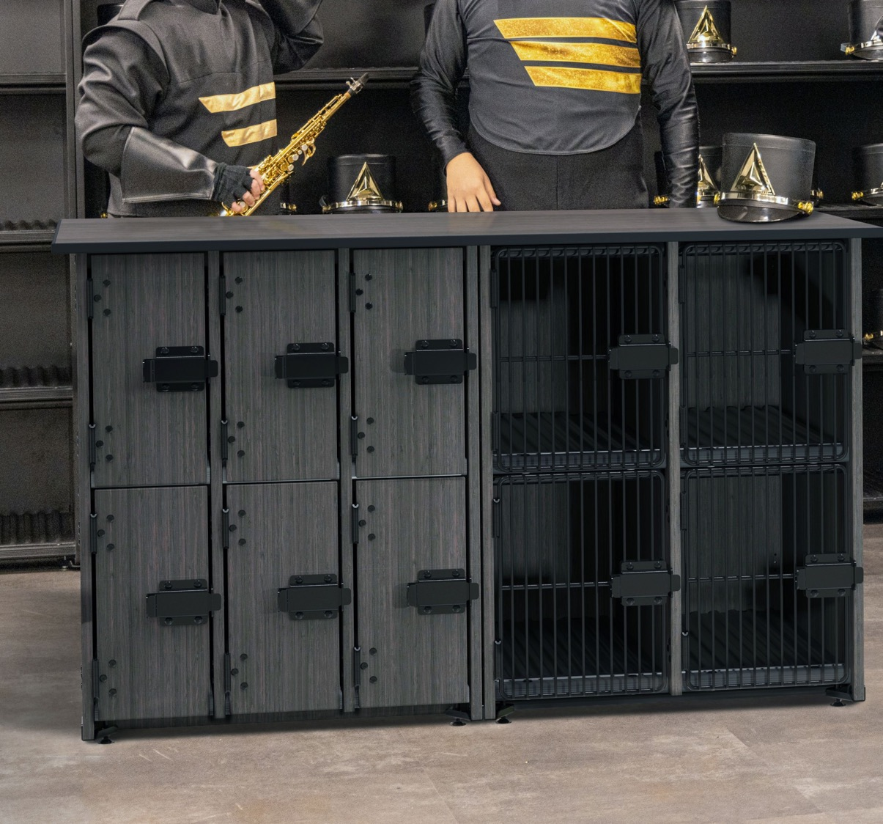
Design Strategies for Future Proofing
Inclusive Design Through Adaptability
Notes:
We touched on this earlier but to reiterate, Inclusive design isn’t static. Flexible storage allows educators to adapt layouts for students with different physical needs, learning styles, and mobility levels. When systems adjust to the learner — rather than the other way around — participation increases and barriers are reduced.

Slide 33
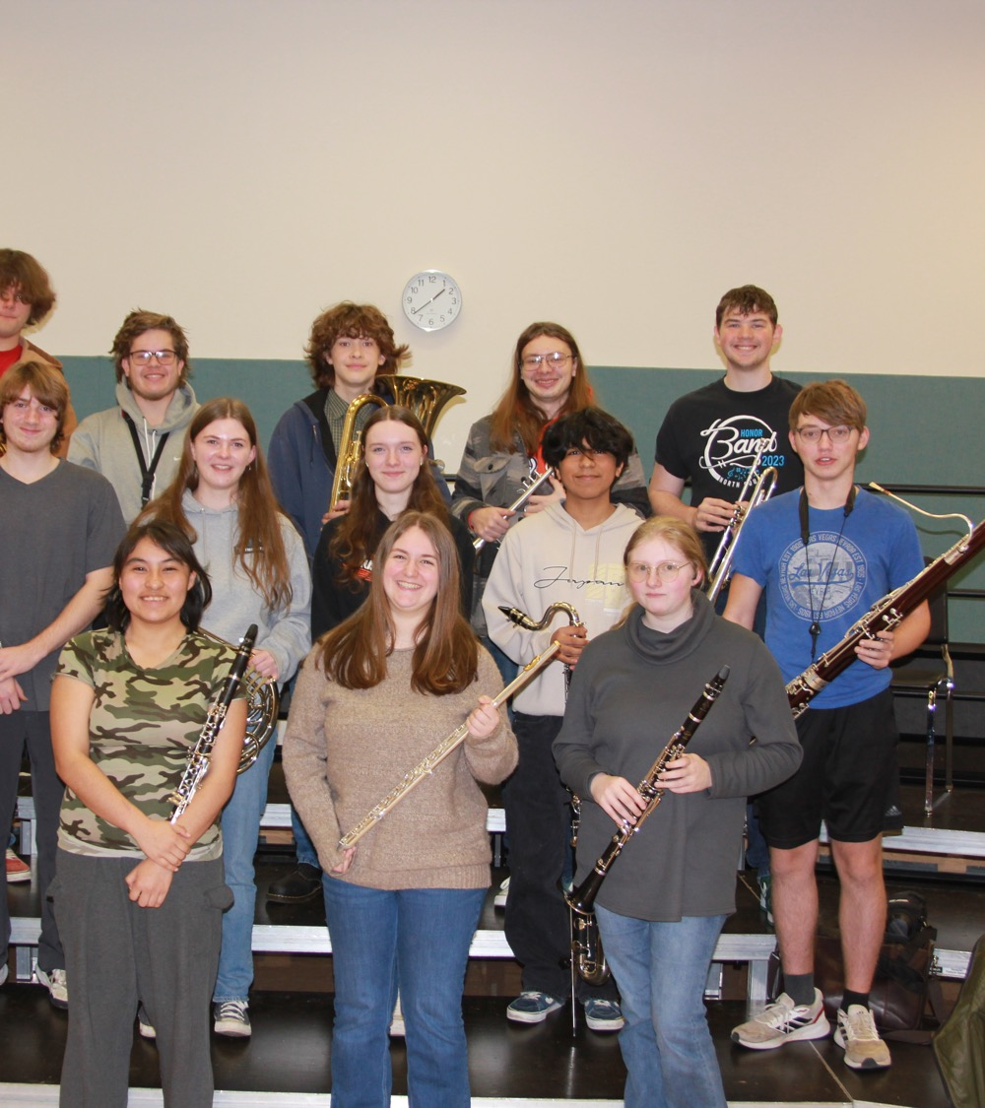
Design Strategies for Future Proofing
FLEXIBILITY FOR CURRICULUM + MULTI-USE SPACES
Supporting Multiple Uses in One Space
Storage adapts to different ensembles
Mobile elements support room configuration
Flexible layouts maximize limited square footage
Notes:
Many music rooms serve more than one purpose — band during the day, small ensembles or performances after school. Flexible storage allows the space to shift quickly between uses without creating clutter or safety issues. This adaptability supports evolving curriculum while keeping the room organized and functional.

Slide 34
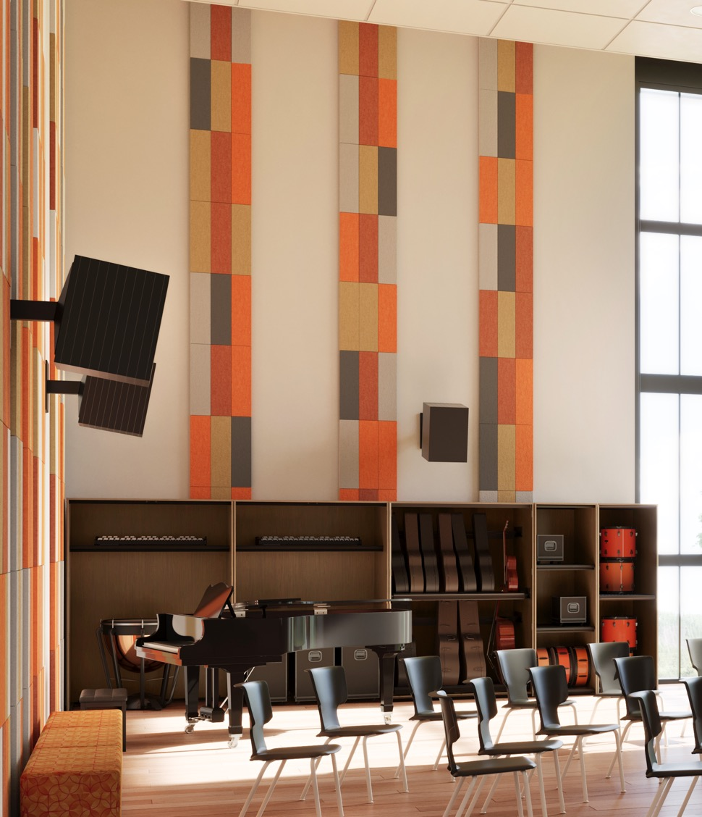
Design Strategies for Future Proofing
PACES
FUTURE-PROOFING THROUGH ACOUSTICS
Designing for Sound Quality Over Time
Acoustic control supports long-term performance
Reduced reverberation improves clarity and instruction
Notes:
Here’s another consideration. Acoustics are not a one-time design decision — they shape how a space performs year after year. As enrollment grows or instrumentation changes, uncontrolled sound quickly becomes a barrier to learning. Future-ready music spaces account for sound management as part of the overall design strategy.

Slide 35
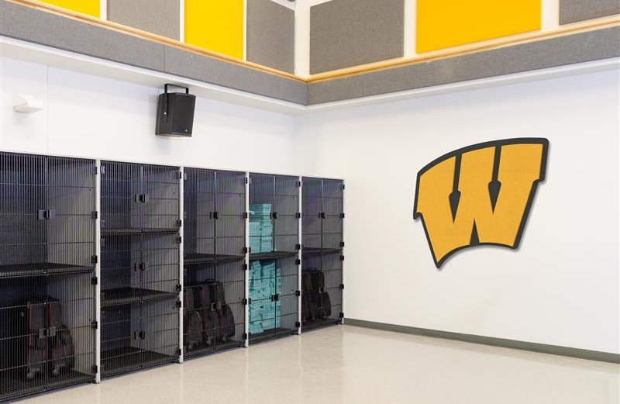
Design Strategies for Future Proofing
Spaces Students Care for Last Longer
Visual identity reinforces ownership and pride
Designed spaces encourage respect and care
Aesthetics support long-term engagement
Notes:
Here’s a positive insight… when students feel connected to a space, they treat it differently. Aesthetic elements that reflect music, creativity, or school identity help build pride — which supports longevity, care, and program sustainability. This isn’t decoration; it’s an engagement strategy that protects the space over time.

Slide 36
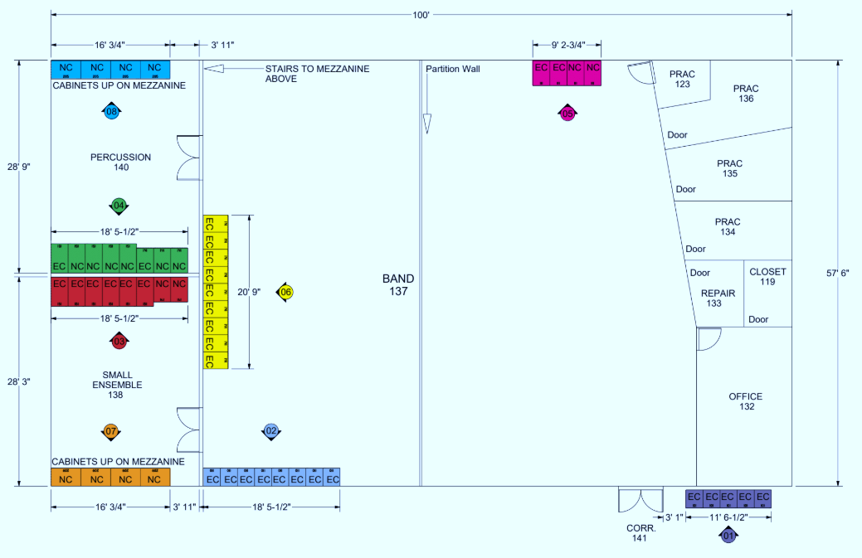
Design Strategies for Future Proofing
ADAPTABILITY ACROSS SCHOOL SIZES
Future-Ready Design Works at Any Scale
Small schools maximize limited space
Large programs manage growth and complexity
Consistent systems support long-term success
Notes:
Future-proofing isn’t just for large districts. Smaller schools benefit from flexible systems that allow one room to do more, while larger programs rely on modularity to manage scale and complexity. In both cases, adaptability ensures the space continues to support learning as programs evolve.“Future-ready music spaces aren’t designed for today’s program alone — they’re designed for what comes next.”

Slide 37
Construction Principles for Long-Term Performance
Notes:
So as we now know, designing for flexibility is essential—but flexibility only works if the system itself is built to last. Let’s look at the construction principles that make long-term performance possible.”

Slide 38
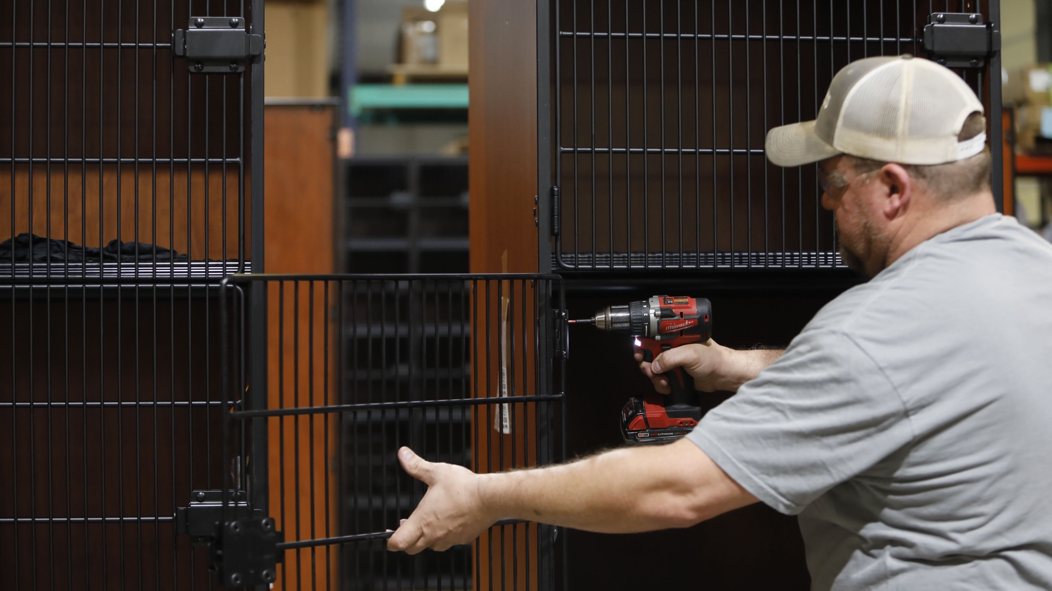
Construction Principals for Long-Term Performance
Longevity Starts with Construction
Notes:
Why does construction matter in music spaces? Well, longevity starts with construction. Music storage isn’t static furniture—it’s handled, moved, loaded, and impacted every day. In these environments, construction quality is what determines whether a system performs consistently or slowly degrades. This section focuses on what designers should look for to ensure long-term reliability and organization.

Slide 39
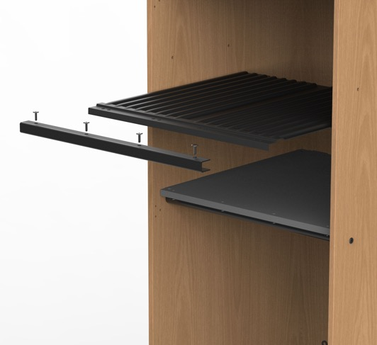
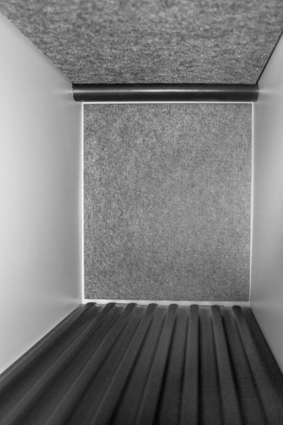
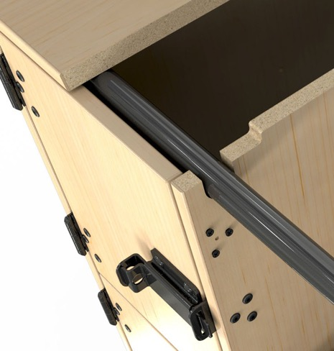
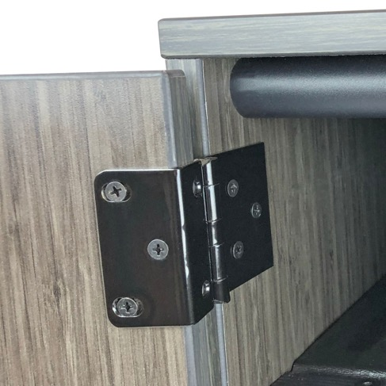
Construction Principals for Long-Term Performance
STRUCTRUAL INTEGRITY + DESIGN BUILT TO WITHSTAND DAILY USE
Notes:
Structural failure doesn’t happen all at once—it happens gradually. Frames that rack or shelves that sag slowly disrupt organization, fit, and safety. Designers should look for construction that maintains its geometry under constant load and movement.

Slide 40
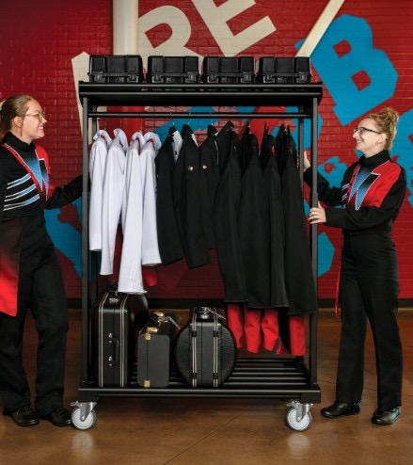
Construction Principals for Long-Term Performance
LOAD MANAGEMENT AND INSTRUMENT SUPPORT: SUPPORTING THE WEIGHT THE RIGHT WAY
Notes:
Large instruments place uneven loads on storage systems. Good construction manages weight intentionally—supporting instruments without pressure on sensitive components. This protects both the instrument and the storage system over time.

Slide 41
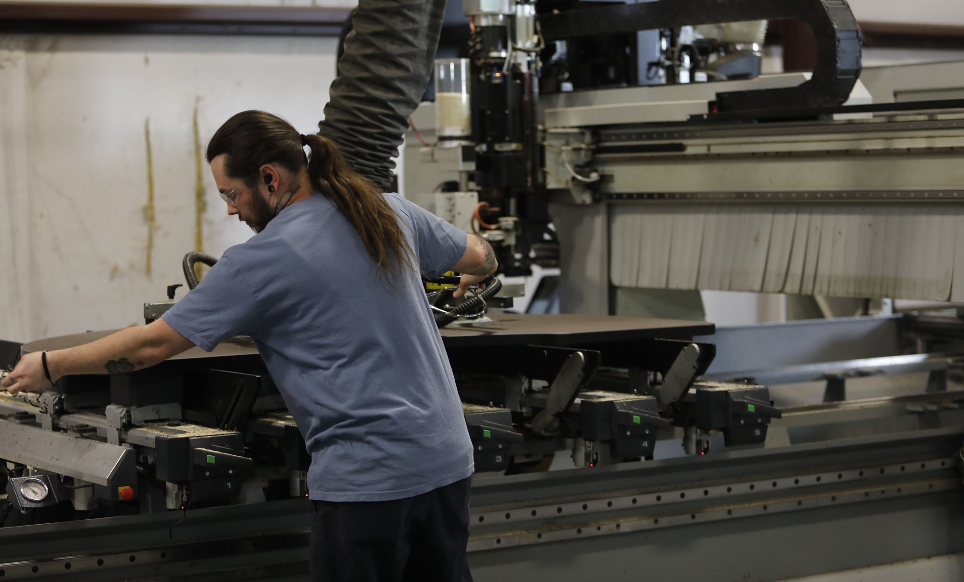
Construction Principals for Long-Term Performance
PRECISION MANUFACTURING + CONSISTENCY
Notes:
Poor precision shows up later as misalignment, uneven spacing, and fit issues—especially when systems expand. Consistent manufacturing ensures that additions integrate cleanly and the room stays organized as programs grow.

Slide 42
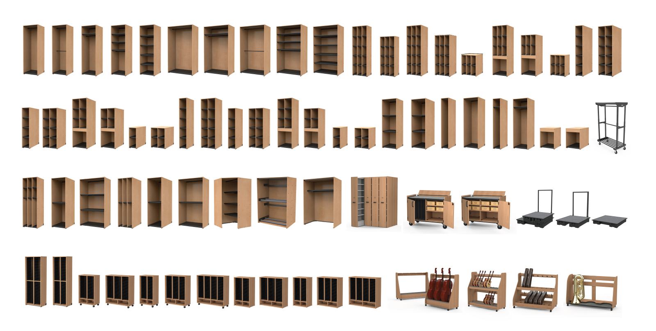
Construction Principals for Long-Term Performance
MODULARITY WITHOUT COMPROMISING STRENGTH AND SOUNDNESS
Notes:
Future-proofing only works if modular systems are engineered to expand without sacrificing strength. Designers should evaluate how components connect and whether structural integrity is maintained across configurations.
When construction supports long-term performance, organization is preserved, maintenance is reduced, and music programs remain reliable for years to come.”

Slide 43
“When music spaces are designed with intention—from organization and safety to durability and flexibility—they perform better for students, educators, and facilities alike.”
Notes:
So that was a lot! We’ve looked at how music environments shape student performance, how safety and ergonomics affect daily use, how construction quality influences long-term cost and reliability, and how flexible design supports evolving programs. When these elements work together, the result isn’t just a better storage system — it’s a music space that performs consistently over time.
And… the best music spaces don’t try to be the star of the show. They quietly support focus, creativity, and performance—so students can do what they came there to do: make music.
Now let’s look at how these design and construction principles translate into real music spaces.

Slide 44
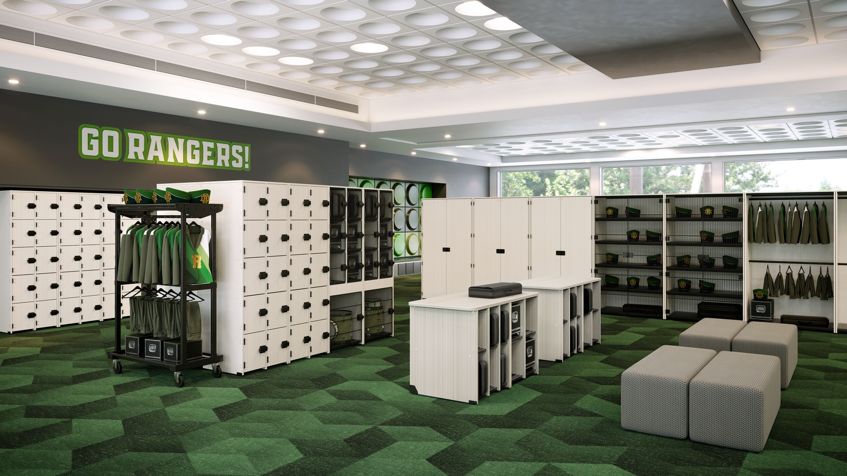

Slide 45
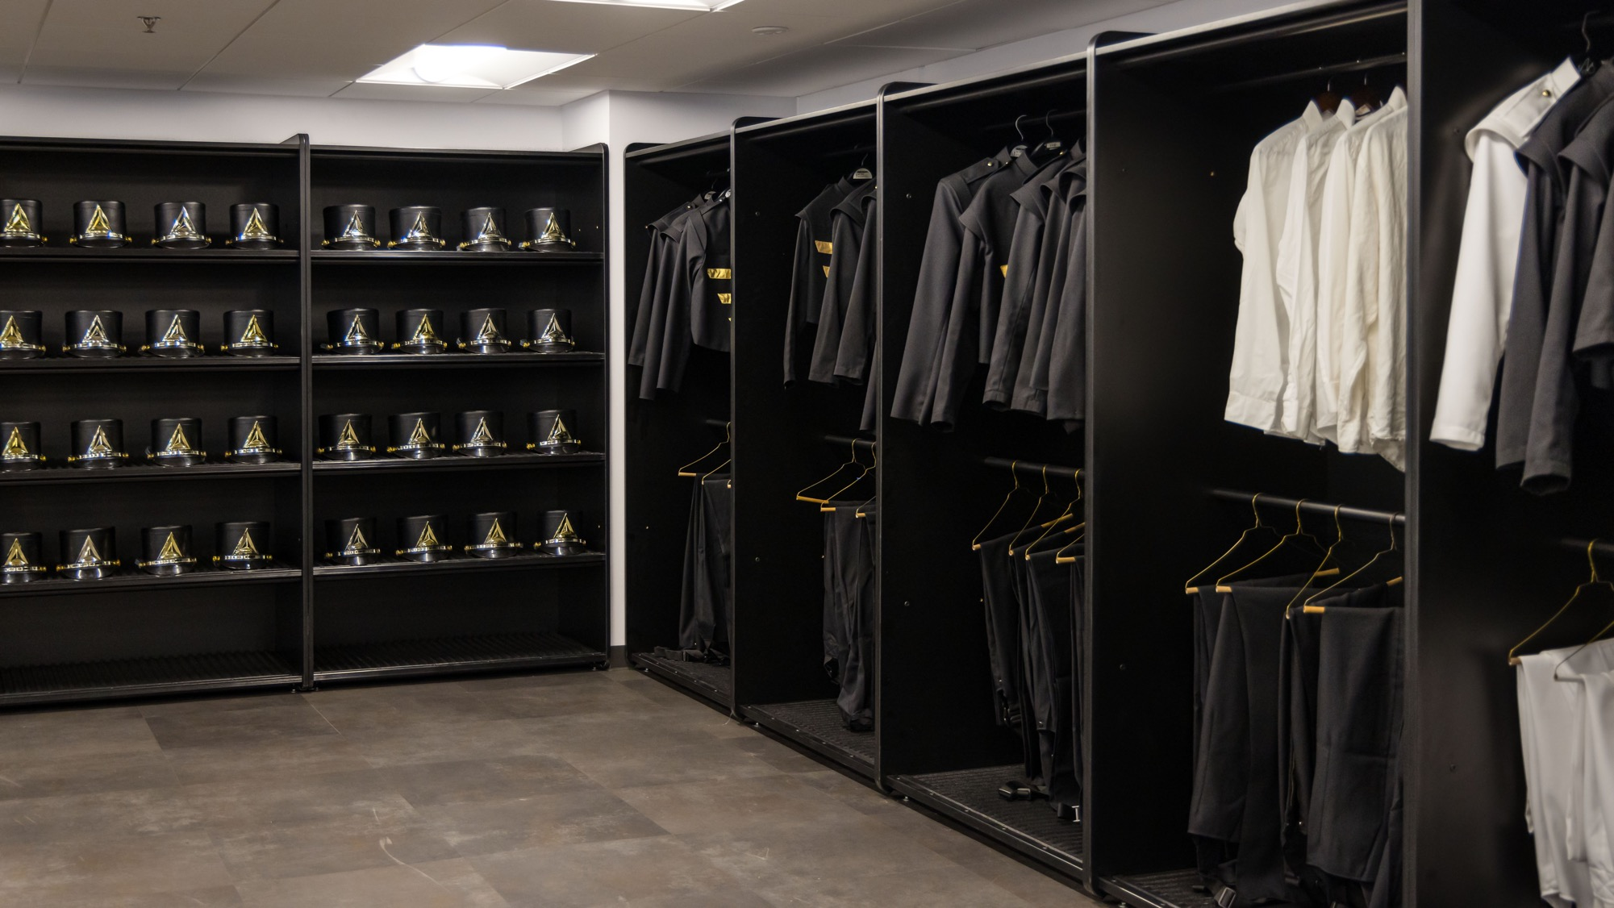

Slide 46
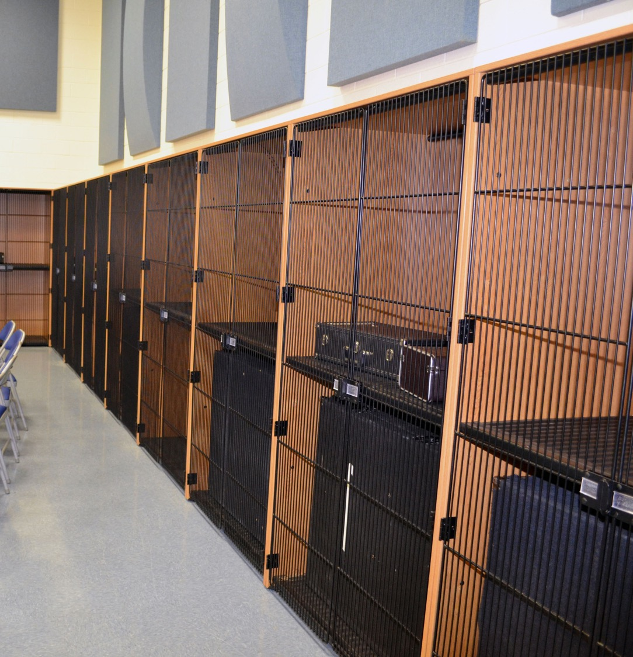
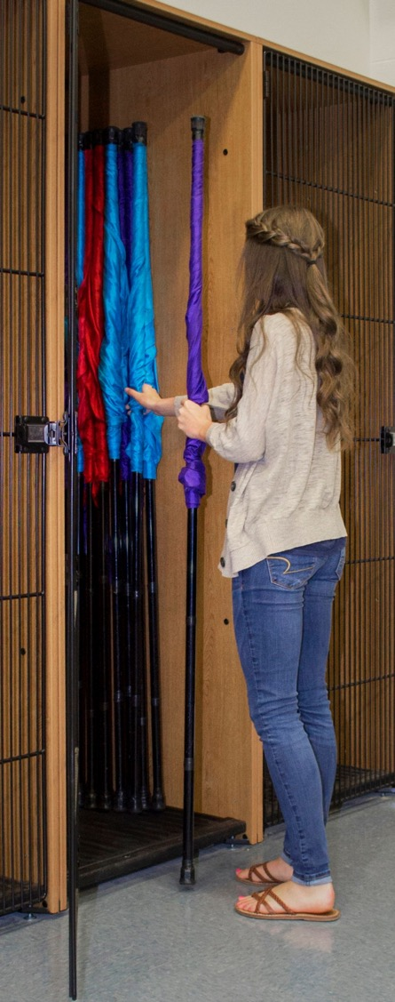
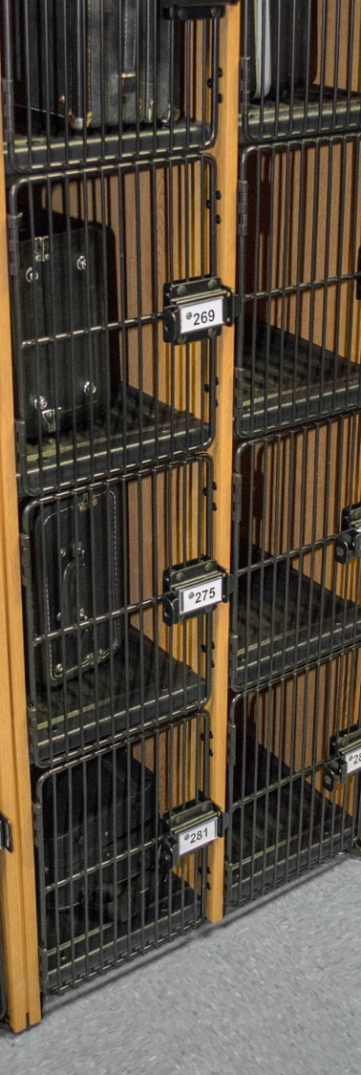

Slide 47
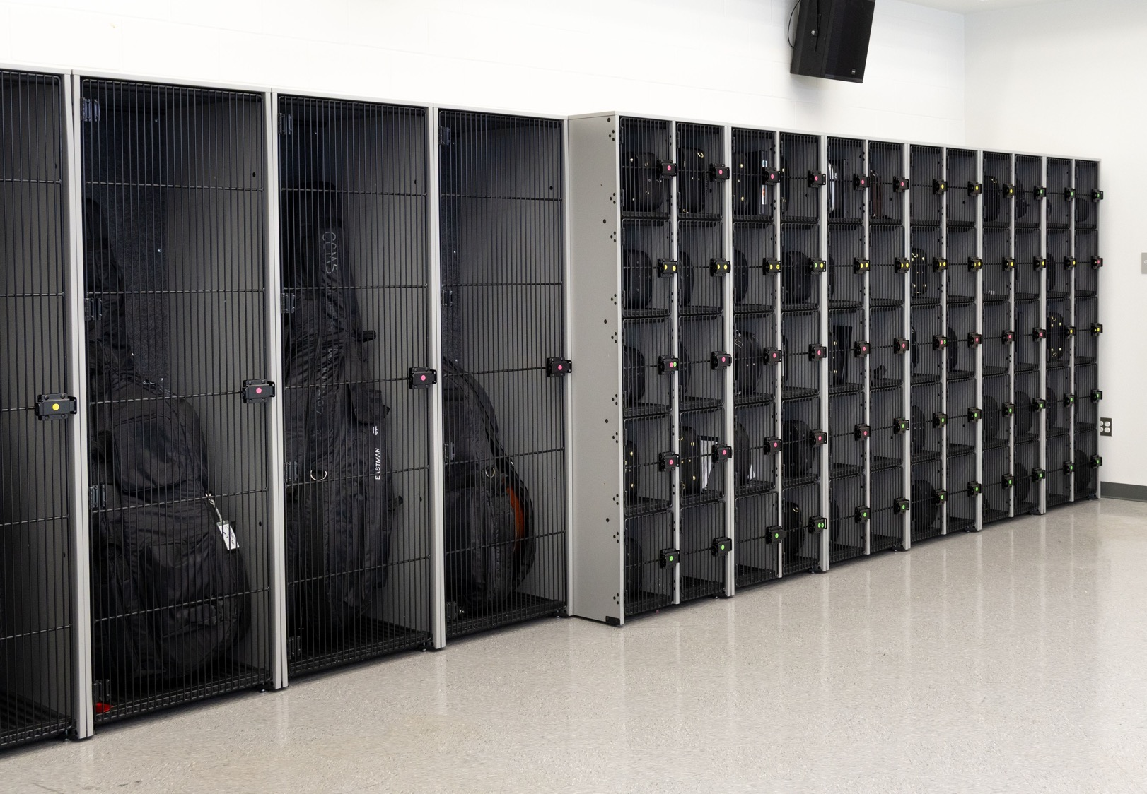
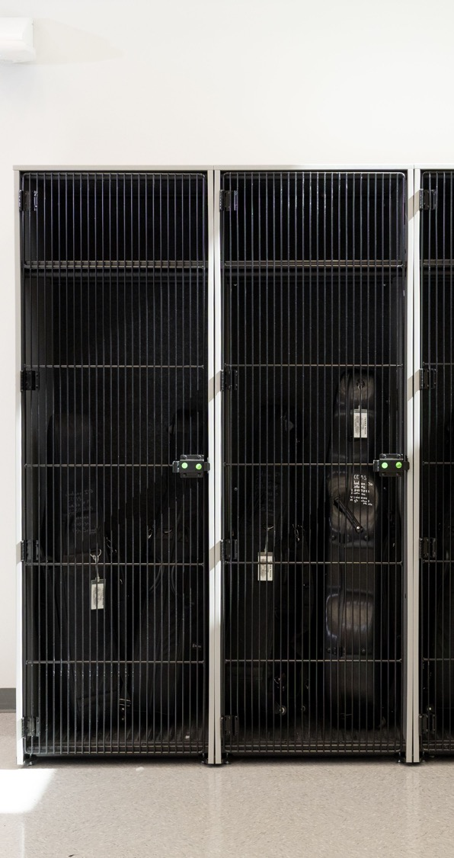

Slide 48


Slide 49


Slide 50




Slide 51


Slide 52


Slide 53


Slide 54



Slide 55


Slide 56


Slide 57
Q+A

Slide 58
BIBLIOGRAPHY
Behind the Music: Designing Safer, Smarter Spaces for Student Success
Barrett, P., Davies, F., Zhang, Y., & Barrett, L. (2015). The impact of classroom design on pupils’ learning: Final results of a holistic, multi-level analysis. Building and Environment, 89, 118–133.
McMains, S. A., & Kastner, S. (2011). Interactions of Top-Down and Bottom-Up Mechanisms in Human Visual Cortex. Journal of Neuroscience, 31(2), 587–597.
Princeton Alumni Weekly. (n.d.). Psychology: Your Attention, Please (summary of Princeton attention research; clutter and attention).
Princeton IPaLab (Princeton University). (n.d.). Article / Document 296 (discussion of clutter/disorganized environments and focus).
National Association for Music Education (NAfME). (n.d.). Eugene Butler quote in What Is the Most Important Thing You Want Your Students to Learn From You?
U.S. Department of Justice. (2010). 2010 ADA Standards for Accessible Design (official ADA Standards landing page).
U.S. Department of Justice. (2010). 2010 ADA Standards for Accessible Design (PDF full text).
U.S. Access Board. (n.d.). ADA Guide: Chapter 3 – Operable Parts (reach ranges / obstructed reach guidance).
International Code Council (ICC). (n.d.). 2010 ADA Standards – Chapter 3 / Section 308 (Reach Ranges) (code reference view).
Corada. (n.d.). 2010 ADA Standards – Section 308 Reach Ranges (including advisory guidance for children).
National Institute for Occupational Safety and Health (NIOSH), CDC.
(2024). Revised NIOSH Lifting Equation (RNLE)
Occupational Safety and Health Administration (OSHA). (2013). Standard
Interpretation: Safe weight limits / NIOSH lifting equation and 51-lb baseline.
American Physical Therapy Association (APTA). (n.d.). Safe Student Lifting and Transfers in the School Setting: A Decision-Making Guide (includes reference to NIOSH 51-lb baseline under ideal conditions).
Acoustical Society of America (ASA) / ANSI. (2010). ANSI/ASA S12.60-2010/Part 1: Acoustical Performance Criteria, Design Requirements, and Guidelines for Schools (Permanent Schools) (PDF).
ANSI Blog (ANSI). (n.d.). ANSI/ASA S12.60/Part 1-2010 (R2020): Acoustics in Schools (overview).
Armstrong Ceilings. (n.d.). Classroom Acoustics and ANSI Standard S12.60 (industry explainer referencing S12.60 concepts: background noise / reverberation).
Maryland Interagency Commission on School Construction. (n.d.). Classroom Acoustics Guidelines (references ASA/ANSI S12.60 and implementation guidance).
EDL Market / EDmarket Essentials. (2024). The Band Room Blues: Why Proper Instrument Storage Matters (design considerations like traffic flow and access).
National Association for Music Education (NAfME). (2022). Starting Your Music Suite Right: A New Construction and Renovation Resource (music-suite planning considerations).
NAfME. (n.d.). How do you make your classroom an inviting and welcoming space for all students? (expectations vs rules; inclusive environment framing).
– Section 308 Reach Ranges (including advisory guidance for children).

